Slide 1
Safety toolbox session
Working on or near energised electrical equipment
Notes:
This Toolbox Session is designed to provide education and awareness on the requirements for working on or near energised electrical equipment.
It aims to encourage meaningful safety conversations.

Slide 2
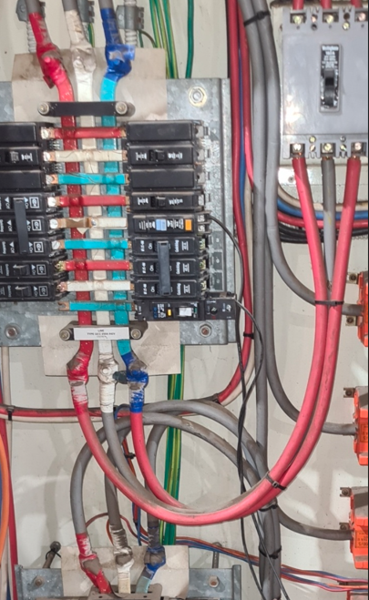
Have you seen a switchboard that looks like this?
Most electrical incidents are preventable. Working de-energised is the safest option.
Work on or near energised electrical equipment should only occur where permitted and when the risks have been thoroughly assessed and managed.
Notes:
Every switchboard is different – not all switchboards are neatly kept.
Particularly older boards which have seen multiple different electricians working on them over 30+ years. They may look chaotic and conceal hidden dangers.
The safest option when working on or near energised electrical equipment is to de-energised. Isolate upstream.

Slide 3
What does it mean to work on or near energised electrical equipment?
‘On or near’ means working on energised electrical equipment OR within three metres of an exposed energised part of the equipment.
‘Exposed part’ means an exposed conductor or an exposed component or an item of electrical equipment.
‘Energised’ means energised by electricity.
Direct or indirect contact with energised electrical parts can cause serious injury or death.
Any activity in the vicinity of energised parts poses risk of initiating an arc flash.
Effective planning, eliminating the need for energised work wherever possible, and applying the right controls can significantly reduce the risk of harm.
Notes:
Refer to the technical guide for safe working on or near energised electrical equipment for a full list of terms and definitions (section 3 – page 5 to 8) Electrical Safety Office technical guides | WorkSafe.qld.gov.au

Slide 4
Common causes of an arc flash
Loose or corroded connections
Damaged, frayed or pinched wires
Poorly terminated or loose electrical connections
Mechanical damage to conductors caused by wayward drill bits, screws driven into energised cables
Rodents, reptiles or insects entering energised switchboards
Ionised gases released from switchgear clearing short circuits
Accidental contact between energised conductors and test probes or other tools.
Notes:
Refer to the technical guide for safe working on or near energised electrical equipment for further information on arc flash (section 5.1, pages 12-14) Electrical Safety Office technical guides | WorkSafe.qld.gov.au

Slide 5
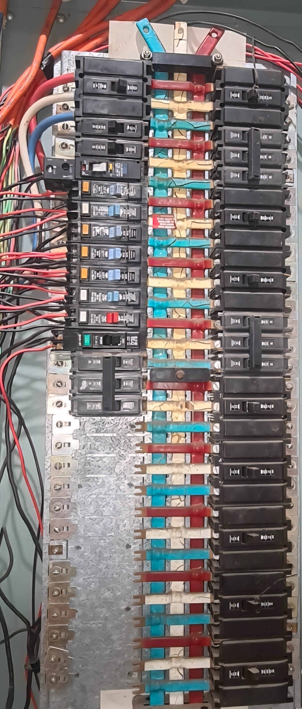
If you are working ON this circuit breaker, and it is switched OFF, are you working on or near energised electrical equipment?

Slide 6
YES
Due to the proximity to energised parts.

Slide 7
When can I work on energised parts?
It is a requirement for electrical equipment to be de-energised when performing electrical work, however, there are prescribed circumstances when it’s ok to do so.
You can only work on or near energised electrical equipment when:
  it is in the interest of health and safety
  it is necessary that the electrical equipment is energised for the work to be carried out properly
  you are testing.
Notes:
It’s a requirement for electrical equipment to be de-energised when performing electrical work.
Before every job involving energised electrical equipment, the first consideration and preference should be to work de-energised (isolate upstream).
Refer to the technical guide for safe working on or near energised electrical equipment for further information on when it is permissible to work on energised equipment (section 4.1, page 8).

Slide 8

Practical examples
Life-saving equipment may need to remain energised and operating while electrical work is carried out on the equipment.
To test a consumer main to confirm correct polarity and neutral integrity.
An electricity entity remains energised and operating while electrical work is carried out to avoid widespread outages.
Notes:
Other examples of testing on or near energised electrical equipment include
detecting a fault or defect in electrical equipment
locating a fault or defect in electrical equipment
measuring the performance of electrical equipment
verifying compliance with the wiring rules.

Slide 9

Preparing to work on or near energised parts
Complete a safe work method statement (SWMS).
A competent person must conduct a risk assessment.
The point at which the electrical equipment can be disconnected or isolated from its electrical supply is clearly marked or labelled, clear of obstruction and capable of being operated quickly.
Consult with the person in control of the business or undertaking (PCBU).
Notes:
Safety is the number on priority when working on or near energise electrical equipment.
Taking a little extra time to ensure the safe work method statement (SWMS) and risk assessment are up to date, accurate and understood by all those undertaking the work can be the difference between going home safely at the end of the day or having a life altering injury or even death.
Refer to the technical guide for safe working on or near energised electrical equipment for further information on the preliminary steps to carrying out electrical work on or near energised equipment (section 4.2, page 9).

Slide 10

Who is a competent person?
A competent person has the knowledge and skills acquired through training, qualifications or experience to perform the required task correctly.
Electrical work may only be performed by a person who:
is the holder of an electrical work licence authorising the work
otherwise authorised to perform the work under the Electrical Safety Act.
Notes:
If you are a competent person, it’s important to remain up to date with training and electrical information so you can provide the most accurate safety advice to people undertaking the electrical work.
Only a competent person can conduct a risk assessment.
Only a competent person can complete the electrical work on or near energised electrical equipment.

Slide 11

Requirements for working on or near energised electrical equipment
The work can only be completed by a competent person who has tooled, testing equipment and personal protective equipment that:
are suitable for the work,
have been properly tested,
are in good working order.
The work must have a safety observer and be performed in accordance with a SWMS and a risk assessment conducted by a competent person.
Notes:
A safety observer (electrical) must be used when performing electrical work on or near energised electrical equipment unless the work involves testing electrical equipment and the risk assessment shows that there is no serious risk associated with the proposed work.
The safety observer’s role should be clearly communicated and understood.
Refer to the technical guide for safe working on or near energised electrical equipment for further information in relation to the role and responsibilities of a safety observer (section 6.3, page 19-20), and the selection, testing, and maintenance of tools (section 7.2, page 23-24).

Slide 12
Preparing a Safe Work Method Statement (SWMS)
A SWMS helps supervisors and workers understand safety requirements for high-risk work.
A SWMS must:
identify the electrical work being undertaken
specify the hazards and risks to health and safety associated with the electrical work
describe the measures to be implemented to control risks such as:
  ensuring the area is clear from obstruction
  marking or labelling where electrical equipment can be disconnected or isolated from its supply and ensuring its clear of obstruction.
describe how control measures will be implemented, monitored and reviewed
include a risk assessment, conducted by a competent person for the relevant work.
Notes:
Refer to the technical guide for safe working on or near energised electrical equipment for further information on preparing a SWMS (section 6, page 17-18).

Slide 13
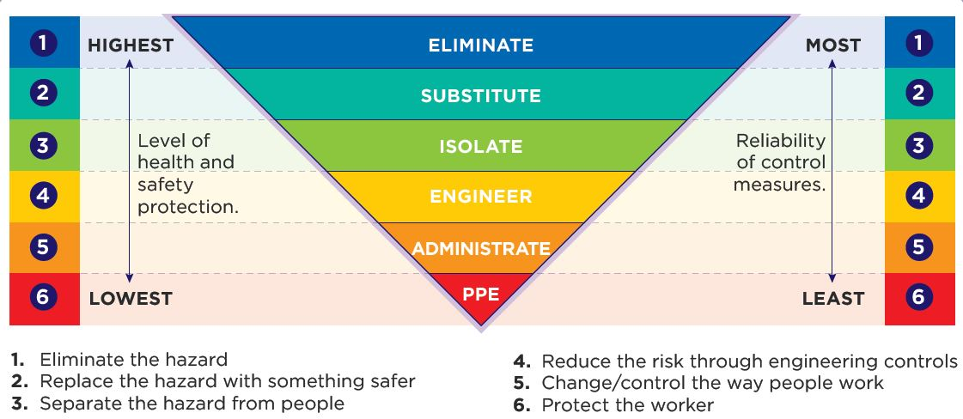
Controlling the risk

Slide 14
Controlling the risk
Elimination
Elimination is the most effective risk control / mitigation method for working on or near energised electrical equipment. Identifying how supply can be isolated or de- energising before commencing work.
2. Substitution
Replacing the higher risk activity with a lower risk. For example, replacing a standard switchboard with one that has been designed and tested for arc-resistant construction.
3. Isolate
Ensure that only authorised persons enter the immediate area in which electrical work on or near energised electrical equipment is being carried out.

Slide 15
Controlling the risk
4. Engineering
Arc resistant switchboards designed to contain and redirect the arc flash. Alternatively, the test equipment design, e.g. using test probes with retractable shrouds and stoppers.
5. Administration
Examples include the preparation of detailed SWMS, risk assessments, work procedures and test procedures.
6. Personal Protective Equipment (PPE)
PPE is not a primary means of control but can be used to supplement higher controls.

Slide 16

Staying safe and compliant
A risk assessment is not a set once and forget!
A new risk assessment is needed when circumstances change, even if you are mid-way through a job.
To remain compliant with Electrical Safey Regulation, you must:
keep a copy of the SWMS available for inspection
ensure the SWMS is understood by all workers, and a copy is accessible to any worker performing electrical work covered by the SWMS.
If a task is not being conducted according to a SWMS or a SWMS is outdated, work must stop immediately or when it is safe to do so. Work can only resume after control measures have been reviewed and are implemented.
Notes:
There have been numerous incidents reported to the Electrical Safety Office (ESO) where workers have obtained significant injuries because of a last minute decision to do an action another way either to save time or because they thought it would be easier another way.
When circumstances change on a job it’s important to STOP, reassess the situation and plan accordingly. Taking an extra 5-10 minutes may save your or another person’s life.

Slide 17
Control measures
Implementing appropriate control measures can ensure you stay safe while working on or near energised electrical equipment.
Control measures to consider when working on or near energised electrical equipment include:
restricting access to an area where work is being carried out on energised electrical equipment
removing conductive materials such as neck chains, rings and watches
considering physical working position in relation to energised parts
appointing a safety observer for high-risk electrical work
completing an emergency plan for the workplace.
Notes:
It is vital control measures are implemented to protect your safety if you’re working on or near energised electrical equipment.
The control measures should be tailored to the job and included in the SWMS.
Everyone involved in the project should be made aware of the control measures and they must be observed before any work on or near energised electrical equipment is undertaken.
Remember, the safest option is to de-energise.

Slide 18
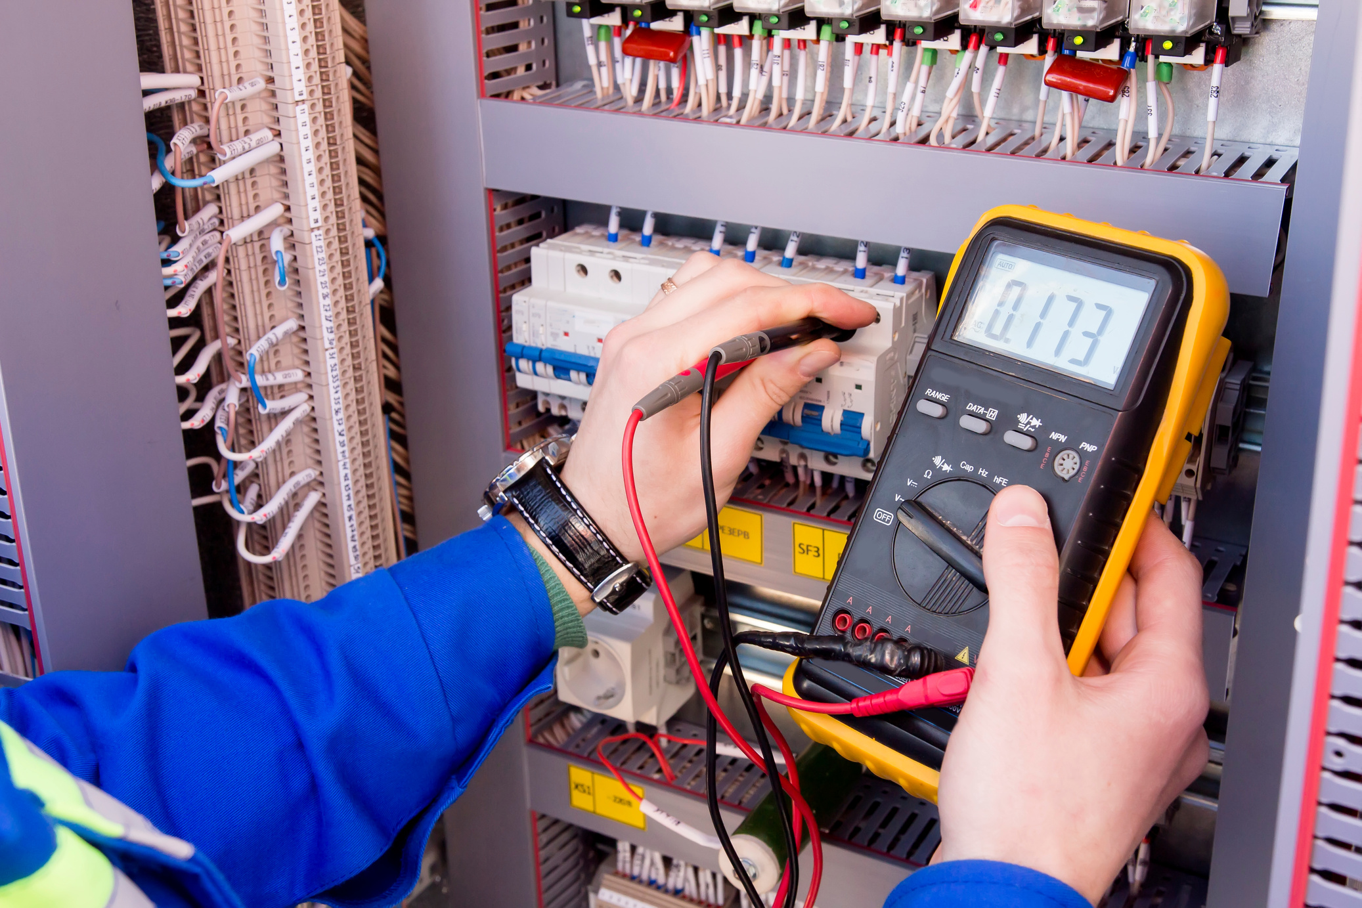
What’s wrong with this picture?

Slide 19
What’s wrong with this picture?
Notes:
Issues:
No leather and voltage rated gloves
Wearing a watch
Wearing a ring on their finger
Holding the testing implements in a manner that increases the likelihood of accidental connection.

Slide 20
Every job starts with a safer choice
Electrical incidents can happen in seconds, but their consequences can last a lifetime.
Most electrical workers are aware of the risk of electric shock when working on or near energised electrical equipment but often fail to identify all the risks and implement control measures prior to commencing work.
Many electrical incidents are preventable. Effective planning, eliminating the need for energised work wherever possible, and applying the right controls can significantly reduce the risk of harm.
Take the time and do a proper assessment. It might just save your life.

Slide 21
Key takeaways
If you a working on or near energised equipment, you must:
isolate upstream
have a competent person complete a risk assessment of the task,
mark the disconnection point clearly and ensure it’s free from obstruction and capable of being operated quickly,
ensure the area is clear of obstruction,
ensure work is only authorised after consultation with the PCBU.
Work can only be performed:
by a competent person with tools and equipment that are suitable, tested and in good working order.
in accordance with a safe work method statement prepared for the work.
with a safety observer unless the work is testing only and the risk assessment shows that there is no serious risk.
Notes:
Remember working on or near energised electrical equipment can be just as dangerous as working live. The safest option is to de-energise!
If this isn’t an option, you must have a SWMS and a risk assessment in place to work on or near energised electrical equipment.
If the conditions of the work change – STOP working immediately or when it is safe to do so – and complete a new risk assessment.

Slide 22
For more information
Electrical Safety Office
Office of Industrial Relations
PO Box 69, Brisbane Qld 4001
Tel 1300 362 128
Contact | WorkSafe.qld.gov.au
Useful links:
Working on or near energised electrical equipment – www.worksafe.qld.gov.au/onornear
Guide for safe working on or near energised electrical equipment

