Slide 1
Reduction in workplace exposure standard for silica dust
For stone benchtop fabrication businesses and workers
Notes:
This is a tool box talk for the stone benchtop fabrication industry on the reduction in the workplace exposure standard for respirable crystalline silica

Slide 2
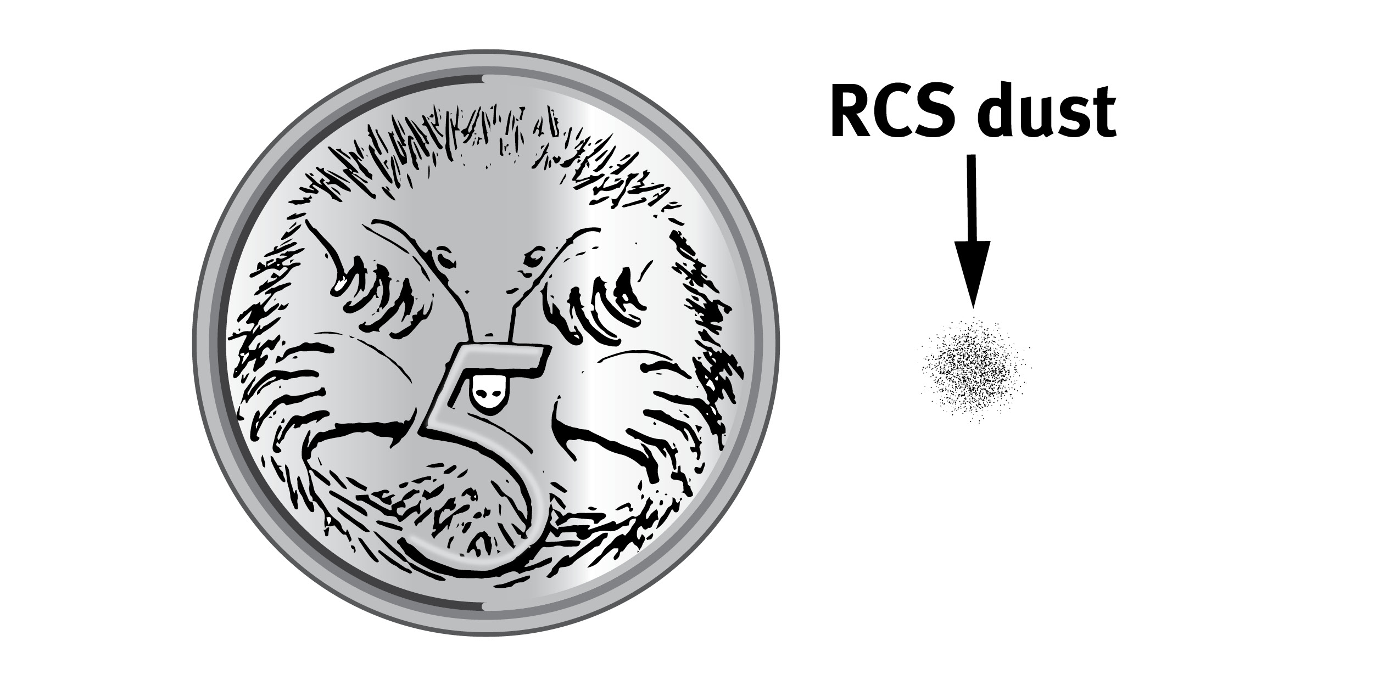
Reduction in workplace exposure standard for respirable crystalline silica
The national workplace exposure standard for respirable crystalline silica (RCS) has been halved from 0.1 mg/m³ to 0.05 mg/m³.
The new workplace exposure standard takes effect in Queensland from 1 July 2020.
The workplace exposure standard will be exceeded if dust breathed in over an eight hour shift contains more silica dust than the amount shown next to the five cent piece.
Notes:
In Australia the national workplace exposure standard for respirable crystalline silica (RCS) has been halved from an eight hour time-weighted average airborne concentration of 0.1 milligrams per cubic metre (mg/m3) to 0.05 mg/m3.
In Queensland this new workplace exposure standard takes effect from the 1st of July 2020.
The workplace exposure standard for RCS will be exceeded if the dust breathed in over a full shift contains more RCS than the amount shown here next to the five cent piece.
Image is on the WHSQ construction dust page. It was adapted from a UK HSE image.

Slide 3
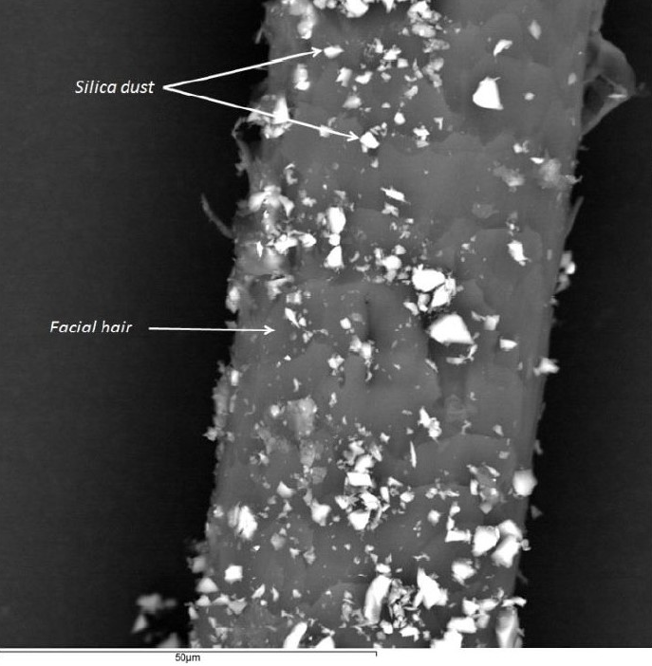
Respirable crystalline silica
Respirable sized crystalline silica dust particles are so tiny they can’t been seen under ordinary lighting and can remain airborne for a long time.
These dust particles are produced by high-energy processes such as cutting, grinding, drilling and crushing silica-containing materials.
Figure 2: Comparison of the size of respirable sized silica dust particles with facial hair.
Notes:
Crystalline silica is a naturally occurring mineral found in materials such as engineered and natural stone, concrete, brick and tiles.
Respirable means it can be breathed into the lungs. RCS is so tiny it can’t been seen under ordinary lighting. You can see the comparison size of the dust as shown in this photo taken through a microscope of RCS on facial hair. The dust can remain airborne for a hours.
These RCS particles are produced by high-energy processes such as cutting, grinding, drilling and crushing silica-containing materials.
Image: Used in the Stone benchtop CoP. Originally from the Australian Tunnelling society http://www.ats.org.au/wp-content/uploads/2018/12/AQWG-Part-10-of-12-RPE-Industry-Considerations-v0.07.pdf

Slide 4
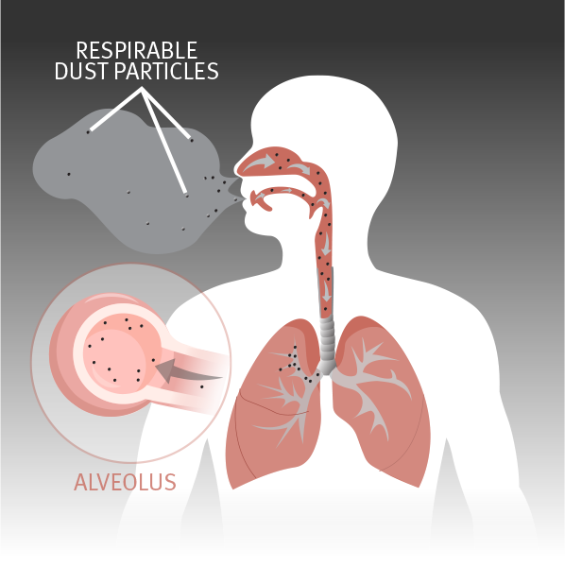
Breathing in silica dust causes lung disease
Breathing in silica dust can cause serious lung diseases including silicosis and lung cancer as well as kidney and immune system disorders.
Silicosis can develop from breathing in respirable sized silica dust every day over months or years.
All silica-related diseases can be prevented using effective controls to stop or reduce the amount of silica dust in the workplace.
Figure #3: Respirable sized silica dust particles can be breathed into the deepest parts of the lung and cause inflammation and scarring
Notes:
Breathing in RCS can cause serious lung diseases including silicosis and lung cancer as well as chronic renal disease and autoimmune disorders. It can reach the deepest parts of the lung and cause inflammation and scarring.
Silicosis can develop from breathing in respirable sized silica dust every day over months or years.
All silica-related diseases can be prevented using effective controls to stop or reduce the amount of silica dust in the workplace.
Image: in Silica and the Lung factsheet. Originally from Queensland Government, Department of Natural Resources and Mines 2019, webpage https://www.dnrme.qld.gov.au/miners-health-matters/what-is-cwp

Slide 5
What does the new exposure standard mean for your workplace?
You must continue to manage your workers exposure to dust and meet your existing work health and safety duties. This means :
prohibiting uncontrolled dry cutting or processing of stone
using dust controls
carrying out air monitoring
providing health monitoring to workers
training workers
providing and wearing respirators.
Notes:
Your business should continue to manage worker exposure to dust and meet your existing duties under Queensland work health and safety legislation.
This means: using higher order dust controls, air monitoring, health monitoring, training for workers and providing of appropriate respiratory protective equipment
The Managing respirable crystalline silica dust exposure in the stone benchtop industry Code of Practice 2019 sets out the minimum standards that must be met. Failure to meet these standards will result in enforcement action.

Slide 6
What does the new exposure standard mean for your workplace?
There are miminum standards set for your industry in the Managing respirable crystalline silica dust exposure in the stone benchtop industry Code of Practice 2019.
Review your work practices to make sure your meeting or exceeding the standards set in the code.
These standards and controls will ensure your workers exposure to RCS is below the new standard.
Notes:
The Managing respirable crystalline silica dust exposure in the stone benchtop industry Code of Practice 2019 sets out the minimum standards that must be met. Failure to meet these standards will result in enforcement action.
Review your work practices to make sure you are following the Code of Practice to make sure worker exposure levels are below the new standard and keeping workers safe. .
The high standard of controls in here in our workplace will ensure that our workers exposure is below the new standard.

Slide 7
Silicosis can’t be cured.
It can be prevented.
You should not cut or process stone without effective controls to:
stop dust at the source
remove dust from the air
stop dust spreading
protect our workers.
Notes:
Remember: Silicosis can’t be cured but it can be prevented.
Use effective controls to stop dust at the source, remove dust from the air, stop dust spreading and protect workers from dust in the air.
If any workers have concerns about controls or worker exposure to respirable crystalline silica please raise your concerns with your supervisors, managers or Workplace Health and Safety Queensland.

Slide 8
To find out more about workplace exposure standards for respirable crystalline silica, effective control measures and health monitoring visit
worksafe.qld.gov.au.
Phone 1300 362 128
email safe@oir.qld.gov.au
Notes:
To find out more . . . . .
Managing respirable crystalline silica dust exposure in the stone benchtop industry Code of Practice 2019
Could also mention factsheets:
Reduction in WES for RCS
Silica and the lung
Selecting the right portable extractor or industrial vacuum cleaner for hazardous dusts
Fit-testing for tight fitting respirators
Also SWA Health Monitoring information and WES information

