Slide 1
PErforM introduction for managers

Slide 2
Aims of the session
Introduce how to use PErforM to identify and control hazardous manual tasks.
Outline workplace commitments and resources required to implement PErforM.
Notes:
2
Outline the aim of the session as per slide
Tell group what the acronym PErforM stands for

Slide 3
Musculoskeletal disorders (MSD)
What is the impact of musculoskeletal disorders on your organisation?
Notes:
3
Ask:
are you aware of the incidence and severity rates in your organisation?
are you aware of the incidence and severity rates in your industry?
It is a major problem and requires much to be done to reduce MSDs
Provide the group with a few statistics on a sheet
How are Hazards: numbers of hazardous manual tasks identified? assessed? controlled?
What are the opportunities for improvement?

Slide 4
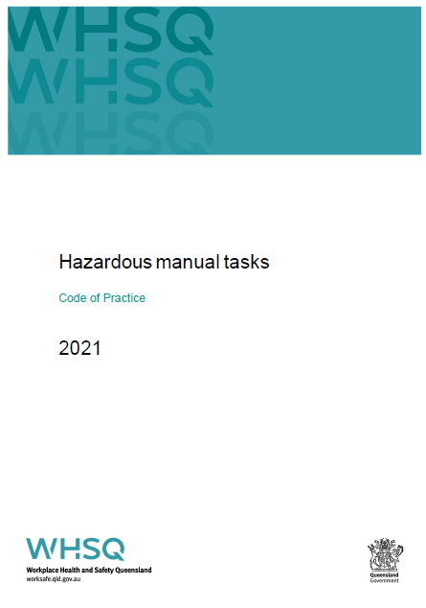
The legislation
WHS Regulation 2011
  hazardous manual tasks, chapter 4, section 4.2.
Code of practice
  Hazardous Manual Tasks Code of Practice 2021.
  Manual Tasks involving the Handling of People Code of Practice 2001.
Notes:
There is a regulation for hazardous manual tasks, chapter 4, section 4.2. The regulation covers all manual tasks including people and animal handling, handling of inanimate and animate objects.
The Hazardous Manual Tasks Code of Practice 2021 (QLD) provides more detailed information on how to manage the risks associated with hazardous manual tasks and achieve the standards required under the regulations. Note there are two small sections in this COP that talks about people and animal handling.
While there is no national people handling COP, there is a QLD Manual tasks involving the handling of people Code of Practice 2001 (currently under review) for managing the high risk associated with people handling activities.
PErforM is an approach to manage hazardous manual tasks risks and help meet compliance of the legislation and COP and is referenced as a risk assessment method in both the National HMT COP and Queensland HMT COP

Slide 5
What does the regulation say?
“A person conducting a business or undertaking must manage risks to health and safety relating to a musculoskeletal disorder associated with a hazardous manual task, under part 3.1”. [s60(1)]
  Part 3.1 describes using a risk management process
Notes:
The duty is on the PCBU
Key phrases are underlined on the slide
‘Manage the risk’ is linked back to Chapter 3, part 3.1 of the regs - includes identifying hazards and managing risks by eliminating or minimising by using hierarchy of control, maintenance of controls measures, review of control measures

Slide 6
Some ways to manage the risk
Management / OHS staff identify, assess and develop controls for hazardous manual tasks (Using COP, risk assessment tools etc).
Consultant to assess and assist in developing controls (ergonomics).
Use workers job knowledge to identify, assess and develop controls (PErforM).
Combination of the above.
Notes:
There are different ways your organisation may chose to manage the risks associated with hazardous manual tasks. Provided there is a system in place that ensure consultation with workers. You might: Discuss options.
Management / OHS staff identify, assess and develop controls for hazardous manual tasks (Using COP, risk assessment tools such as ManTRA etc)-
Bring in an OHS consultant with an ergonomics specialty to assess and assist in developing controls (Ergonomics)
Use workers job knowledge to identify, assess and develop controls (PErforM)
Combination of these

Slide 7
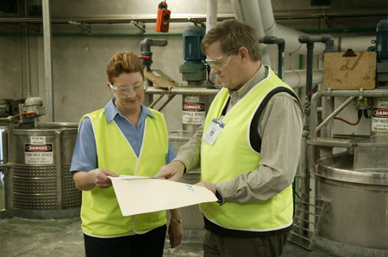
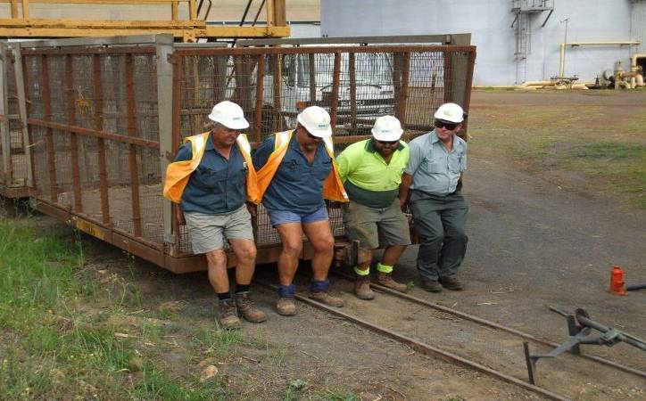
What is PErforM?
Participative Ergonomics for Manual tasks.
simplified manual task risk management program.
based on a participative ergonomics approach.
internationally recommended approach for reducing musculoskeletal disorders.
Notes:
Very briefly for those of you who have not heard of PErforM : it is a simplified manual task risk management program and the acronym represents “Participative Ergonomics for Manual tasks”
It is based on the premise of the worker being the expert and involves the training of workers to identify and assess manual tasks risks in their work tasks as well as generate control ideas to reduce the risks.
Locally developed:
Workplace Health and Safety Queensland
University of Queensland
Curtin University of Technology
Users:
mining, civil construction, construction, manufacturing, wholesaling, health, aged care, food processing, timber and transport

Slide 8
PErforM elements
Outcomes
participation of
workers and
‘others’
team training
communication
integrated in
systems
risk management
evaluation
control of manual
tasks risks
management
commitment
and support
improved health,
productivity
and safety culture
site champion
Adapted from P.Vink et al. (2006). Applied Ergonomics. 537-546.
Notes:
8
This model is a summary of the critical elements of the PErforM program,
Worker participation, management commitment/ support and a site champion are critical components to the program. The ‘others’ in the model relates to the other stakeholders’ or people impacted by any change made to work processes. Depending on the complexity of the task being assessed , the others might include people such as engineers , suppliers, designers and ergonomists if necessary. It’s important other stakeholders need to be identified and involved at the outset of the program.
Participative ergonomics is an approach which utilises the expert knowledge that workers have of their own tasks by involving them in improving their workplace. Many risk assessment tools involve an observer (often external person to the process – such as a consultant). This person may do some data gathering and complete a risk assessment and make some recommendations. The process for many risk assessment tools ends here. PErforM is different because it is about involving the workers and relevant others in the whole process from identifying problem manual tasks to the development and implementation of controls.
The fat blue arrow in the model highlights the important components of a successful participative ergonomics intervention including:
Team training for workers and leaders to understand relevant ergonomics concepts and techniques
Communication between workers and management as to the stages of the program and implementation outcomes
The use of a risk management process
Embedding the PErforM program in the existing safety management system.
A process to evaluate the success of the intervention and consider and risk assess any potential risks introduced by the changes.

Slide 9
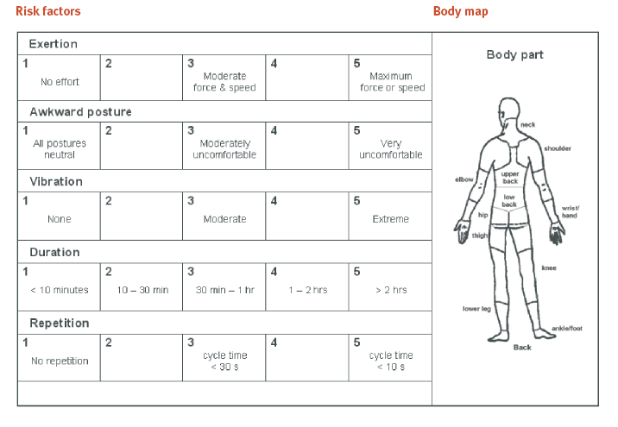
PErforM task - worksheet 2
Notes:
Here is an example of a completed risk factor assessment.
In this example you can see that there is a high risk for the shoulders and the lower back in regards to force posture and duration and a high risk for the wrists in regards to duration and cycle time. Controls (which will be discussed later in the workshop) should be aimed at reducing these risks.
This assessment can be used to re assess the task after controls have been implemented to see if the desired risk reduction has occurred.
Some limitations of the PErforM risk assessment
PErforM is a simplified manual tasks risk management approach and as such, there are some compromises with the use of PErforM.
For example:
Complex tasks may require the use of other ergonomic assessment tools, or the engagement of an expert to assist with the assessment and development of controls. The need for greater expertise may also be identified when prioritising control options.
The risk assessment tool does not take into account the cumulative effect of the range of manual tasks a worker may perform during their shift. As a result, work teams will need to make some judgements about:
which tasks are the hazardous tasks
the priority order for their assessment
whether the worker is being exposed to similar risk factors throughout the shift despite performing different tasks.
If this is the case, consider controls which minimise the cumulative risk.

Slide 10
Scenario – lifting lid on pre-heater box
Lid was:
- catching on the lip of the pre-heater resulting in forceful jerky movements
-heavy and awkward to lift.
Worker exerting force and awkward
postures to lift the lid on the pre-heater.
Notes:
This task was carried out at a manufacturing company that employed 310 workers.
In 2011, the company implemented the PErforM program and this is one of the tasks they assessed and controlled.
The company’s PErforM risk assessment team was made up of workers and managers, including its casting plant team leader, casting operational staff and health and safety advisor.
hazardous manual task?
The task assessed was lifting the lid on a pre-heater unit, which is a large enclosed box that maintains tools placed inside at about 55 degrees centigrade. This task was being completed regularly each day, with operators required to open the lid of the preheater, to change the tools approximately once per shift. Lifting the lid on the pre-heater was observed as a potential hazardous manual task. Workers advised that the lid was catching on the lip of the pre-heater resulting in forceful jerky movements when trying to lift the lid, and that the lid was heavy and awkward to lift. (refer to picture)

Slide 11
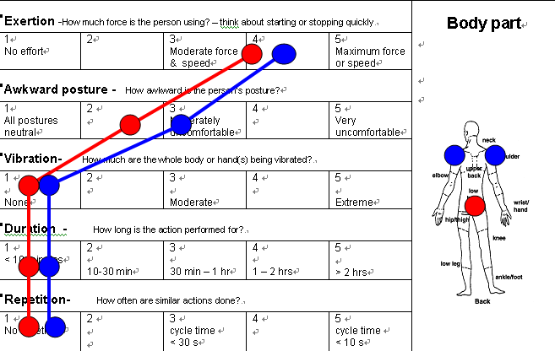
Risk assessment – before control
Notes:
Using the PErforM risk assessment worksheet, the company’s work teams identified that opening the lid on the pre-heater exerted high force through the shoulders and back and resulted in moderately uncomfortable awkward postures through the shoulders.
Considering the scores – what controls could be made- any ideas

Slide 12
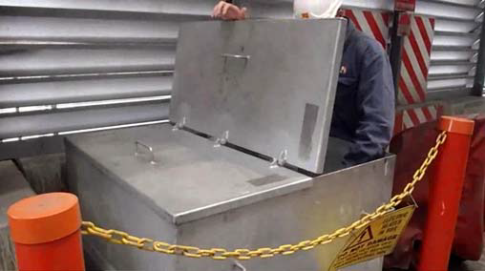
PErforM team control measure
Forceful exertions and awkward postures were reduced by repairing the lid so that it no longer caught on the lip of the pre-heater.
By putting a hinge down the middle of the lid it can easily be opened from each side.
Worker opening pre-heater
with lid cut in half and hinges
installed.
Pre-heater with lid cut in half
and hinges installed.
Notes:
What was the company’s solution?
Forceful exertions and awkward postures were reduced by repairing the lid so that it no longer caught on the lip of the pre-heater, and by putting a hinge down the middle of the lid so that it can easily be opened from each side.
Outcomes and benefits
The repair and modifications to the lid minimised the hazardous manual tasks associated with lifting the lid on the pre-heater unit and were simple and cost effective to implement.
Implementing the PErforM program demonstrated management commitment to addressing work health and safety risks and gave workers ownership of the solution. Worker involvement in identifying the issues and developing the solution was vital in ensuring the best and most sustainable solution was chosen.

Slide 13
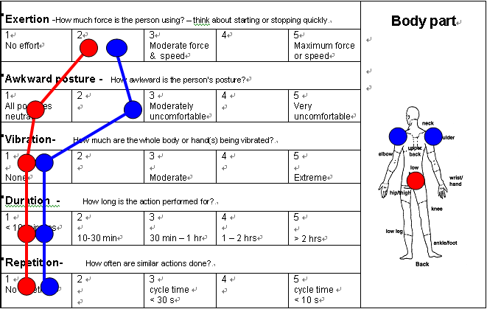
Risk Assessment – after control
Notes:
This is the follow up assessment after the control was put in place.
The company saved more than $200,000 in workers' compensation insurance costs and significantly reduced statutory costs over a twelve-month period after implementing PErforM. They have assessed over 30 hazardous manual tasks with controls put in place to minimise the risk.
In 2010–11, their workers' compensation premium rate was $1.38 and in 2011–12 it dropped to $0.97 - a considerable saving.
Similarly, the company's average statutory cost - the true cost of what was being paid in medical bills after an injury had occurred - reduced by almost 400 per cent in 2011–12, reflecting a significant reduction in incident severity.

Slide 14
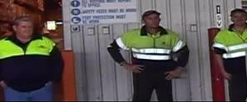
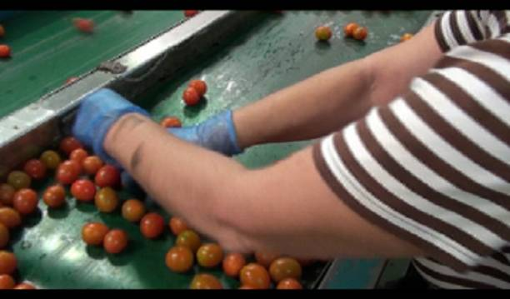
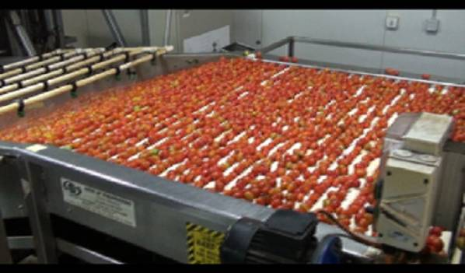
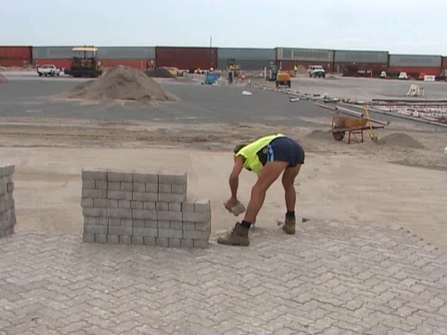
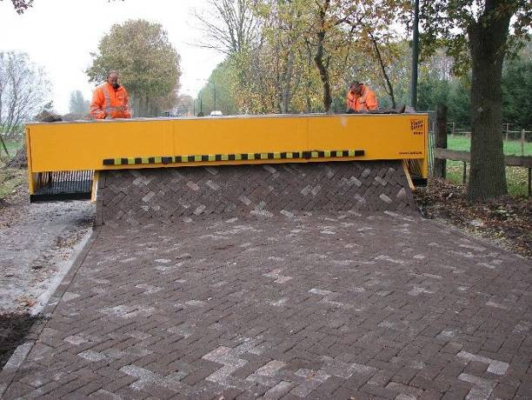
Hierarchy of control
Work teams are trained to use control the hierarchy to eliminate or reduce risk
Elimination
Elimination
Engineering
Notes:
The Manual Tasks regulation requires PCBU's to work through the hierarchy of controls (S36). Note: The levels on the slide refer to page 27 of QLD’s HMT COP 2021 and page 18 of the How to Manage Work Health and Safety Risks COP 2021.
Engineering controls are preferred over administrative controls because they eliminate or minimise the risk and are permanent.
Administrative controls are reliant on human behaviour i.e. the worker following the correct procedure, they only reduce exposure to the risk, may be forgotten under stressful conditions, and require ongoing supervision.

Slide 15
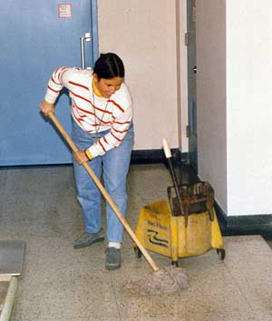
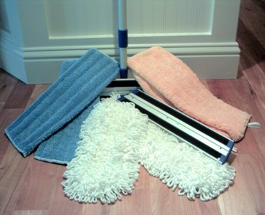
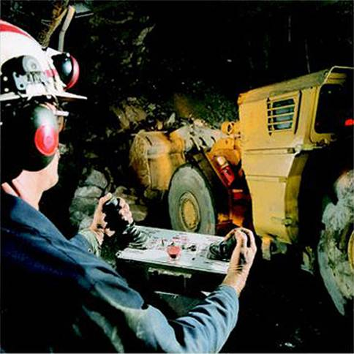
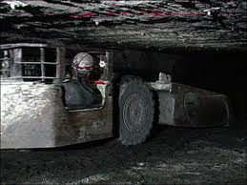
Hierarchy of control
Substitution
Isolation
?
?
Notes:
Discuss examples here.

Slide 16
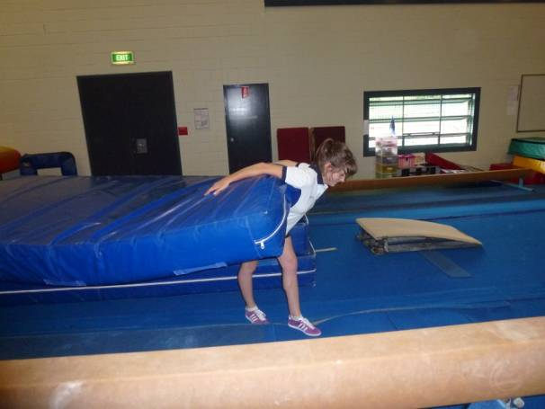
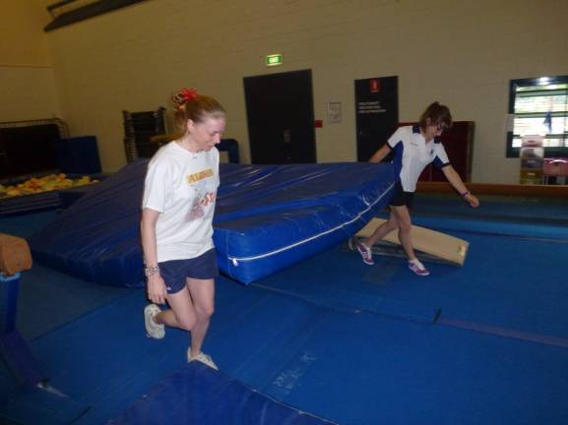
Administration
Team lift
Job rotation.
Change of workflow.
Task specific training.
Preventative maintenance program.
Personal protective equipment.
Notes:
Suggested Activity- refer back to whiteboard examples the group identified as hazardous manual tasks in their workplace and ask what controls are currently in place to manage the risk. Discuss where they belong in the hierarchy

Slide 17
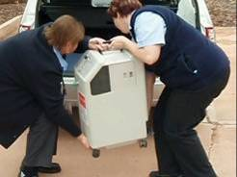
Why lifting technique training is not enough
Evidence to date does not support lifting technique training on its own as a control for manual tasks risks.
Risk factors are not changed.
Notes:
17
It is apparent that many workplaces are relying on lifting technique training as a sole control or a significant part of their manual tasks control strategy.
So how effective is lifting techniques training in controlling manual tasks risks?
Being at the bottom of the hierarchy this control relies on worker behaviour and supervision.
To date the research is fairly convincing as there is no evidence that lifting technique training reduces injury data, pain and discomfort of workers.
This control relies on the worker doing the right thing, using the “lifting techniques”.
The key issue is that the risk factors are not changed in anyway so that even if the worker uses the lifting technique he/she may still be at risk. There is no “safe” way to lift. The question that should be asked is why does the worker have to lift? Can we do it another way eg eliminate or use a design control.
Refer to “lifting technique training; Is it effective” WHSQ fact sheet/web page
Examples of research (if required)
A very large controlled trial of 4000 U.S postal workers with over 5.5 yrs of follow up included a 2 session back school ( physical therapist) of 3 hours of training with 3-4 reinforcement sessions over the succeeding few years. Found no long term benefits with training. (Daltroy, L.H., Iversen, M.D., Larson, M.G., Lew, R., Wright, E., Ryan, J., Zwerling, C., Fossel, A.H., Liang, M.H. (1997). A controlled trial of an educational program to prevent low back injuries. The New England Journal of Medicine, Vol. 337, Number 5, 322-328.)
2001 review of 9 investigations showed strong evidence that back schools are not effective in prevention (Linton, Van Tulder and Mauritus, 2001) ) , Only one showed a positive impact on initial sick leave and duration of symptoms. (Linton, S.J. & van Tulder, M.W. (2001). Preventive interventions for back and neck pain problems. Spine, Volume 26, Number 7, 778-787.)

Slide 18
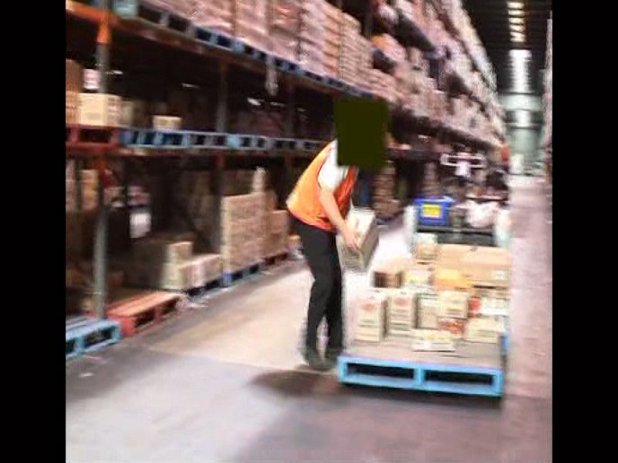
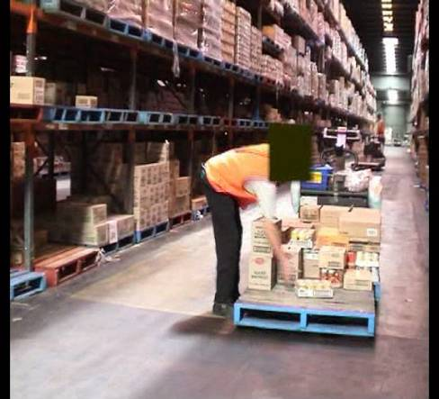
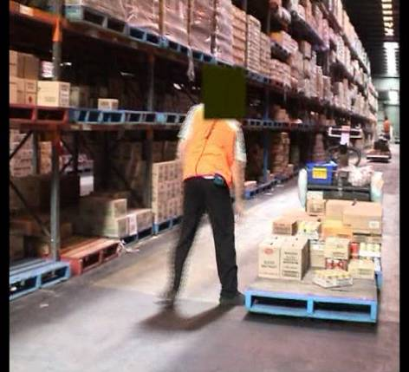
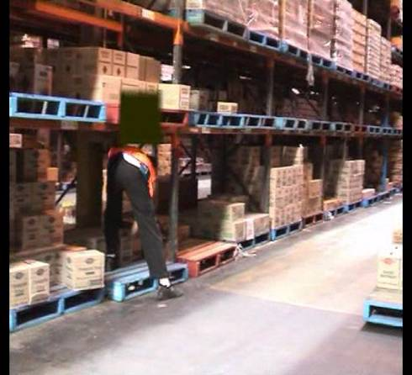
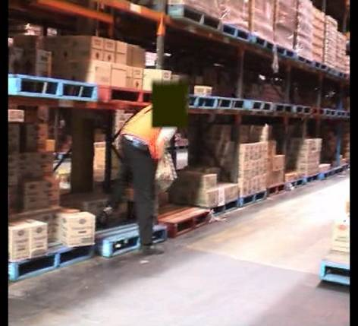
Work example
1
2
3
6
4
5
Notes:
18
18
Recommend: you insert your own video of a manual task from your workplace that illustrates that lifting technique training is ineffectual because of the poor layout or design issues.
This example is in a warehouse. Work is 8hrs a day. Order pickers manually unload stock from shelves onto pallets located at floor level. The stock weight is 2kg-15kg. Workers are given a set number of orders per day.
This worker may have been provided with lifting technique training. However “lifting correctly” is difficult to do in this situation given the design issues.
Encourage group discussion about the task eg identify the direct stressors and what is causing them (work area design- height of shelf resulting in stooping, location of pallet-requiring awkward postures, load handling issues and nature of the load are not as obvious from the video, however need to take into consideration-? The weights being handled, duration of exposure and the repetition).
Discuss what would be better controls than lifting training eg raising height of racking, pulling pallet out from under racking, raising height of pallet.

Slide 19
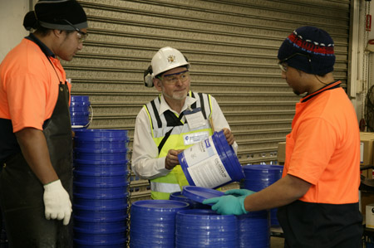
What type of training is appropriate?
Training should include information on:
  manual task risk management
  specific manual task risks and the measures in place to control them
  how to perform manual tasks safely, including the use of aids, tools and safe work procedures
  how to report a problem or maintenance issue.
Notes:
Training in the type of control measures implemented should be provided during induction into a new job and as part of an ongoing manual tasks risk control program.
The training should include info on:
Manual tasks risk management , including characteristics of hazardous manual tasks
Specific manual tasks risks and the measures in place to control them
How to perform manual tasks safely including the use of mechanical aids , tools , equipment and safe work procedures
How to report a problem or maintenance issue
( Hazardous Manual tasks COP 2021)

Slide 20
Potential benefits for business
Effective controls.
A positive impact on:
  musculoskeletal symptoms
  reducing injuries and workers compensation claims
  a reduction in lost days from work or sickness absence.
Meets consultation requirements and improves communication.
Ownership of controls.
Improved safety culture.
Improved productivity.
Notes:
20
The potential advantages to this method with worker involvement include:
work carried out in more optimum postures with good ergonomic design and reduced physical risks will have a positive impact on productivity and quality –research supports this. ( to provide fact sheet)
the development of more effective controls. The controls will target the specific risk factors and importantly they will be useable by workers, in their work environment – because they know what works, and what doesn’t. Relate example of where external person chooses a control which is impractical/unsuitable for use by workers and ends up being never used / waste of money.
provide a sense of ownership for everyone - and therefore a commitment to the whole process in particular re implementing new controls.
Improved safety culture including more rapid acceptance of organizational change, Less injuries, less turnover , less absenteeism
Participative ergonomics also relies on good communication strategies between all levels of staff – and this can contribute to improved morale and productivity.
are all associated benefits to participative ergonomics

Slide 21
Management leadership
Management commitment to safety.
Enforce procedures.
Supportive and open to safety suggestions.
Safety communication.
Active involvement in safety.
Due diligence requirements.
Notes:
Many researchers have found that management support and leadership are strong influencing factors in affecting health and safety outcomes. WHSQ have found that it is critical for success that the organisation management actively support the PErforM program.
Management commitment to safety is associated with a reduction in risk-taking behaviours and violations, lower levels of self-report incidents and higher levels of learning from safety events.
Perceptions that safety policies and procedures are enforced and consistently implemented are associated with lower levels of incident under-reporting, self-report injury incident and higher levels of satisfaction with the organisation.
Leader support for safety and openness to safety suggestions is associated with higher levels of employee willingness to raise safety issues, lower levels of self-report injuries, higher levels of satisfaction with the organisation and can lead to a long-term improvement in safe working practices.
Safety communication between management and the workforce is associated with a reduction in the levels of risk-taking behaviours, promotion of positive safety behaviours and reduced levels of self-report work-related pain.
Active involvement in safety helps promote perceptions of a positive safety climate and fosters increased levels of employee accountability and responsibility for safety
AS per HSE “A review of the literature on effective leadership behaviours for safety “ published 2012- an extensive review of published evidence from the last 10 years- capturing current knowledge in the area of leadership.
Due diligence in relation to ensuring health and safety is defined for the first time in the model Work Health and Safety Bill. In demonstrating due diligence, officers will need to show that they have personally taken reasonable steps to:
-acquire and update their knowledge of health and safety matters
-understand the operations being carried out by the person conducting the business or undertaking in which they are employed, and the hazards and risks associated with the operations
-ensure that the person conducting the business or undertaking has, and uses, appropriate resources and processes to eliminate or minimise health and safety risks arising from work being done
-ensure that the person conducting the business or undertaking has appropriate processes in place to receive and respond promptly to information regarding incidents, hazards and risks
-ensure that the person conducting the business or undertaking has, and uses, processes for complying with duties or obligations under the WHS Bill.
As part of due diligence requirements, officers need up to date knowledge about safety issues. They must also ensure that their employer and workers have ready access to information that will help them to avoid risks and hazards in the workplace.
Refer to PErforM resource manual for workplace trainers for PErforM business case template (Appendix 11).

Slide 22

Video - Steve Qld Chamber of Commerce on management commitment to health and safety
Notes:
22
So as Steve and Adrienne highlighted good safety leaders are actively involved in safety.

Slide 23
Video - Adrienne Tracy, Ergonomics consultant, about what safety leaders did that resulted in better outcomes during a recent pilot program
Notes:
23
And now we will hear from Adrienne Tracy, Ergonomics consultant, about what safety leaders did that resulted in better outcomes during a recent pilot program.

Slide 24
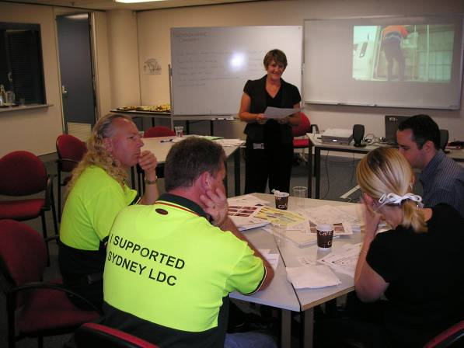
Planning
Management commitment.
Appoint a PErforM champion.
Develop implementation plan.
Develop performance indicators.
Notes:
24
Management commitment is critical in order to ensure that adequate resources are given for the successful roll out of PErforM in the workplace/organisation.
Appoint a PErforM Champion This person/s may complete the PErforM for trainers workshop-(this workshop). The champions hold a key role in that they are responsible for facilitating the implementation of PErforM within the workplace. The champion assists by training the work teams in PErforM. This is also a key role. We have developed a role description of the key attributes needed to drive PErforM within your organisation Refer to appendix 3 of the resource manual for key attributes of the Champion. Have the Champion attend a train the trainer.
Develop implementation plan about how the program will be implemented and communicated in the organisation. Refer to the resource manual appendix for an example of an initial action plan.
Performance Indicators: “What is measured is managed”. Does the organisation rely on lagging/ outcome indicators or more proactive measures? For example: number or percentage of hazardous manual tasks controlled with higher order elimination/engineering controls.
Lagging or outcome indicators do not reflect the causes of injuries (only the injuries themselves), and often do not reflect the level of risk. Under-reporting of incidents can also occur due to peer pressure to keep these rates low.
Positive performance indicators (PPIs) focus on assessing the success of an organisation’s WHS performance by monitoring the processes that produce good WHS outcomes. PPIs focus on preventative workplace activities and can be used to help develop improvement strategies

Slide 25
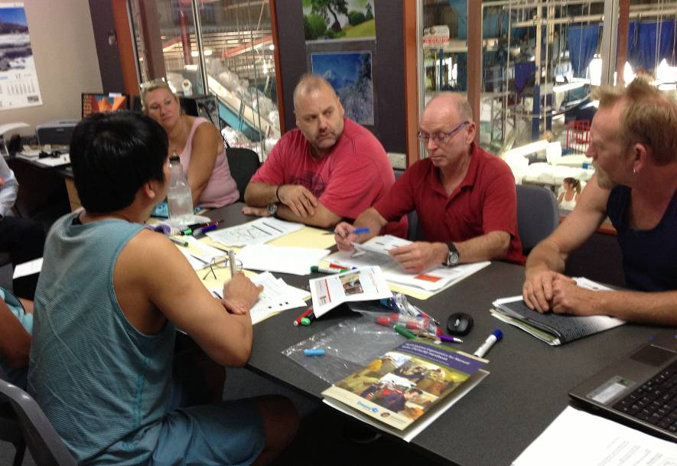
Implementation plan
Select a pilot work team / pilot site.
Identify PErforM teams.
Identify hazardous manual tasks.
Obtain video footage.
Training.
Notes:
Consider a pilot? - Identify work teams and high-risk manual tasks - Identify work teams (approximately 8–10 people ideally) to participate in the training. Suitable work teams may be identified for a variety of reasons, for example:
the work they perform involves high risk manual tasks
the team has experienced a number of manual tasks related injuries or incidents, and/or
their willingness to participate in the program.
Determine appropriate high risk manual tasks for consideration in the workshops and obtain video footage of the tasks for analysis
Conduct work teams training- include supervisors and managers as appropriate. Work teams training is an essential part of the PErforM program. The PErforM approach requires work teams to be:-
knowledgeable about risk management framework,
to have the skills and tools required to assess manual tasks risks,
to understand the risk control hierarchy and
to have knowledge of general principles of control strategies for eliminating and controlling manual tasks risks.
Training workers to acquire these skills and work within a risk management framework is a key focus
Work teams guided through a risk assessment of a high-risk task performed in their workplace and the development control ideas. Incorporates video footage of specific workplace tasks

Slide 26
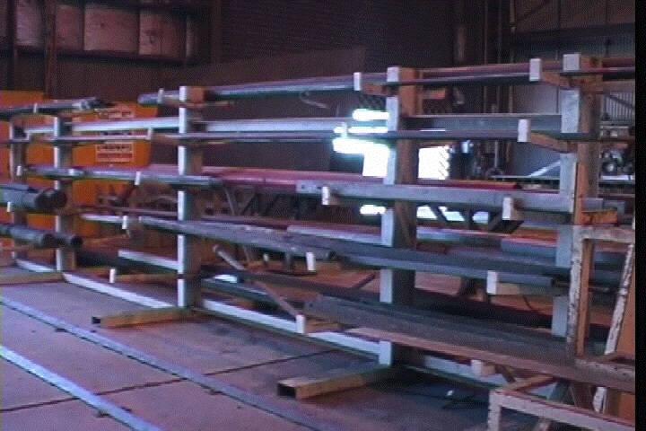
PErforM implementation
Work team conducts risk assessments.
Develop control ideas.
Process for management to consider controls.
Controls implemented.
Ongoing process.
Monitor and review.
Notes:
26
Conduct risk assessments - Continue with risk assessments and generating control ideas using the PErforM process. This is just the beginning. Work groups will continue with risk assessments for high risk tasks using the PErforM process.
Implement controls - Once the work teams have identified controls - these suggestions are forwarded to management for appropriate action. In mining each site formed a committee to coordinate the evaluation and implementation of the control suggestions (typically composed of safety staff, site engineer, worker rep, and management rep). The aim is for the committee to take ownership of the process and for it to become self sustaining. A decision matrix is available in the appendix of the resource manual.
Where managers fit in: assist work teams with risk assessment, ensure focus on hierarchy of controls, provide or obtain necessary resources
Monitor and review. This is a very important part of the risk management process and essential to ensure that changes made have effectively controlled the risk and not introduced any new hazards

Slide 27
PErforM resources
WHSQ workshops.
Resource and trainers manuals.
Work teams handbook.
Web based resources and information from Workplace Health and Safety Queensland website.
Tool box presentations.
Notes:
27
A number of resources have been developed to assist in the delivery of PErforM (ongoing continual improvement is needed)
These resources include:
PErforM for management PowerPoint presentation (this presentation), which provides managers with a 20–30 minute overview of PErforM.
PErforM for trainers PowerPoint presentation, to train the trainer in the PErforM program. You can use it in your workplace to train trainers within your organisation.
PErforM for work teams PowerPoint presentation, to train work teams about the manual tasks risk factors and in using the PErforM risk assessment tool.
PErforM frequently asked questions handout, which answers common questions asked by managers about PErforM
PErforM resource manual, which provides guidance on preparing for and delivering the PErforM program including evaluation.
Participative Ergonomics for Manual Tasks handbook-The handbook includes the PErforM risk assessment tool – show this to the group. It has great information and a chart to assist in rating and prioritising the risk. It then takes the work group through the identification of controls; and includes case studies.
WHSQ support – WHSQ can provide support to you and your organisation while you implement the PErforM program. Support may consist of mentoring/advice and can be negotiated depending upon your requirements.
Other web based guides and information – there are a range of information products available on the WHSQ web site that may assist you eg Injury hot spots, the Sprains and strains prevention guide and the Prevention of Slips, trips and falls guide.
N.B- Encourage workplaces to brand material as their own. Copyright only on the tool. Otherwise all PowerPoints , resource manual can be branded.

Slide 28

PErforM – keys to success
Management commitment.
Site champion.
Good communication.
Workforce participation.
Achievable goals.
integrated into management systems.
Notes:
28
Tips for the successful implementation of PErforM
The following tips have been developed as a result of the knowledge gained from the implementation of PErforM in a variety of industries. Following these tips will assist in the successful implementation of PErforM in the workplace.
Management commitment – As previously discussed, it has been found that the success of PErforM is dependent on commitment from managers and supervisors especially when there may be perceived competing priorities such as production and safety. It is important to gain this commitment before commencing the PErforM program. Otherwise adequate resources may not be provided and the program could fail.
Site champion – As previously discussed a skilled and trained coordinator plays a critical role in promoting and ‘driving” the program including ensuring that the necessary communication occurs at all levels of the organisation and that the essential activities are undertaken.
Good communication - Ongoing communication between management, workers, and relevant others about what is happening is critical. For example, when designing new or modifying existing controls, engineers should consult with workers throughout the process to ensure that the end product will suit the worker’s requirements. Keeping everyone informed, including those who work different shifts, can be done through existing communication channels such as noticeboards, toolbox talks, or emails.
Involvement of ALL – As previously discussed everyone should be involved
Achievable goals - Focus on a few simple tasks and easily implemented controls initially to gain confidence with the process and to demonstrate that it can work. It is important to have a positive, “can do” attitude and to be realistic. Solutions to all problems may not be possible but it is important to remember that there are always some things that can be done. Small changes can make a big difference to reducing the overall level of risk, so focus on what can be done.
Integrated into management systems - PErforM is best implemented as part of an organisation’s health and safety management system eg attached to incident reports, used when developing JSAs.

Slide 29

Discussion - Where to from here?
Decide if your workplace would like to use the PErforM program.
Develop a plan of action.
Notes:
29
There are gains to be achieved with the PErforM programme
Firstly decide whether your organisation wants to take on this program. It requires commitment, on-going support, and encouragement.
Obtain management commitment to the program
Develop a plan of action
Register for a train the trainer workshop

Slide 30



Contact us
www.worksafe.qld.gov.au
1300 362 128

