Slide 1
Keeping young workers safe
For supervisors and managers
Notes:
Who is this workshop for?
This 45 minute workshop is designed to be delivered to groups of supervisors and managers that have responsibility for young workers in a workplace.
It should be delivered by a WHS manager or other workplace leader.
General tips for delivering an effective workshop:
The speaking points throughout this presentation provide guidance on what can be said to complement the presentation slides.
Adapt the presentation slides and speaking points to suit your presentation style, audience and what you want to achieve.
Include relevant experiences and stories where possible.
Set aside at least 45 minutes and the end of the presentation for questions and discussion. Focus on creating a positive discussion that motivates the audience to apply the information and ideas presented.
Find a suitable room or area within the workplace that is comfortable and free from distractions.
You can deliver the workshop in one session or across multiple sessions, depending on what will work best for your workplace.
Follow up with your attendees a few weeks after the workshop to see how they have been applying what was covered in the workplace.

Slide 2
Overview
The need to take action.
How to influence the health and safety of young workers.
Workshop – Ideas for improvements.
Committing to action
Notes:
Welcome attendees and introduce yourself.
The purpose of this session is to give you, those who supervise and manage young workers, an understanding of how some of their characteristics can make them more vulnerable to a workplace injury and what can be done to support them in working safely.
The workshop will cover four sections:
In section one, we will consider why health and safety is important for our young workers, using one young person’s story as an example.
In section two we will look at the four areas that influence a young person’s health and safety at work.
In section three, we will run a quick workshop that will capture your ideas for how we can improve these four areas.
In section four, we will commit to some steps to make these improvements happen.

Slide 3
Section one:
The need to take action

Slide 4
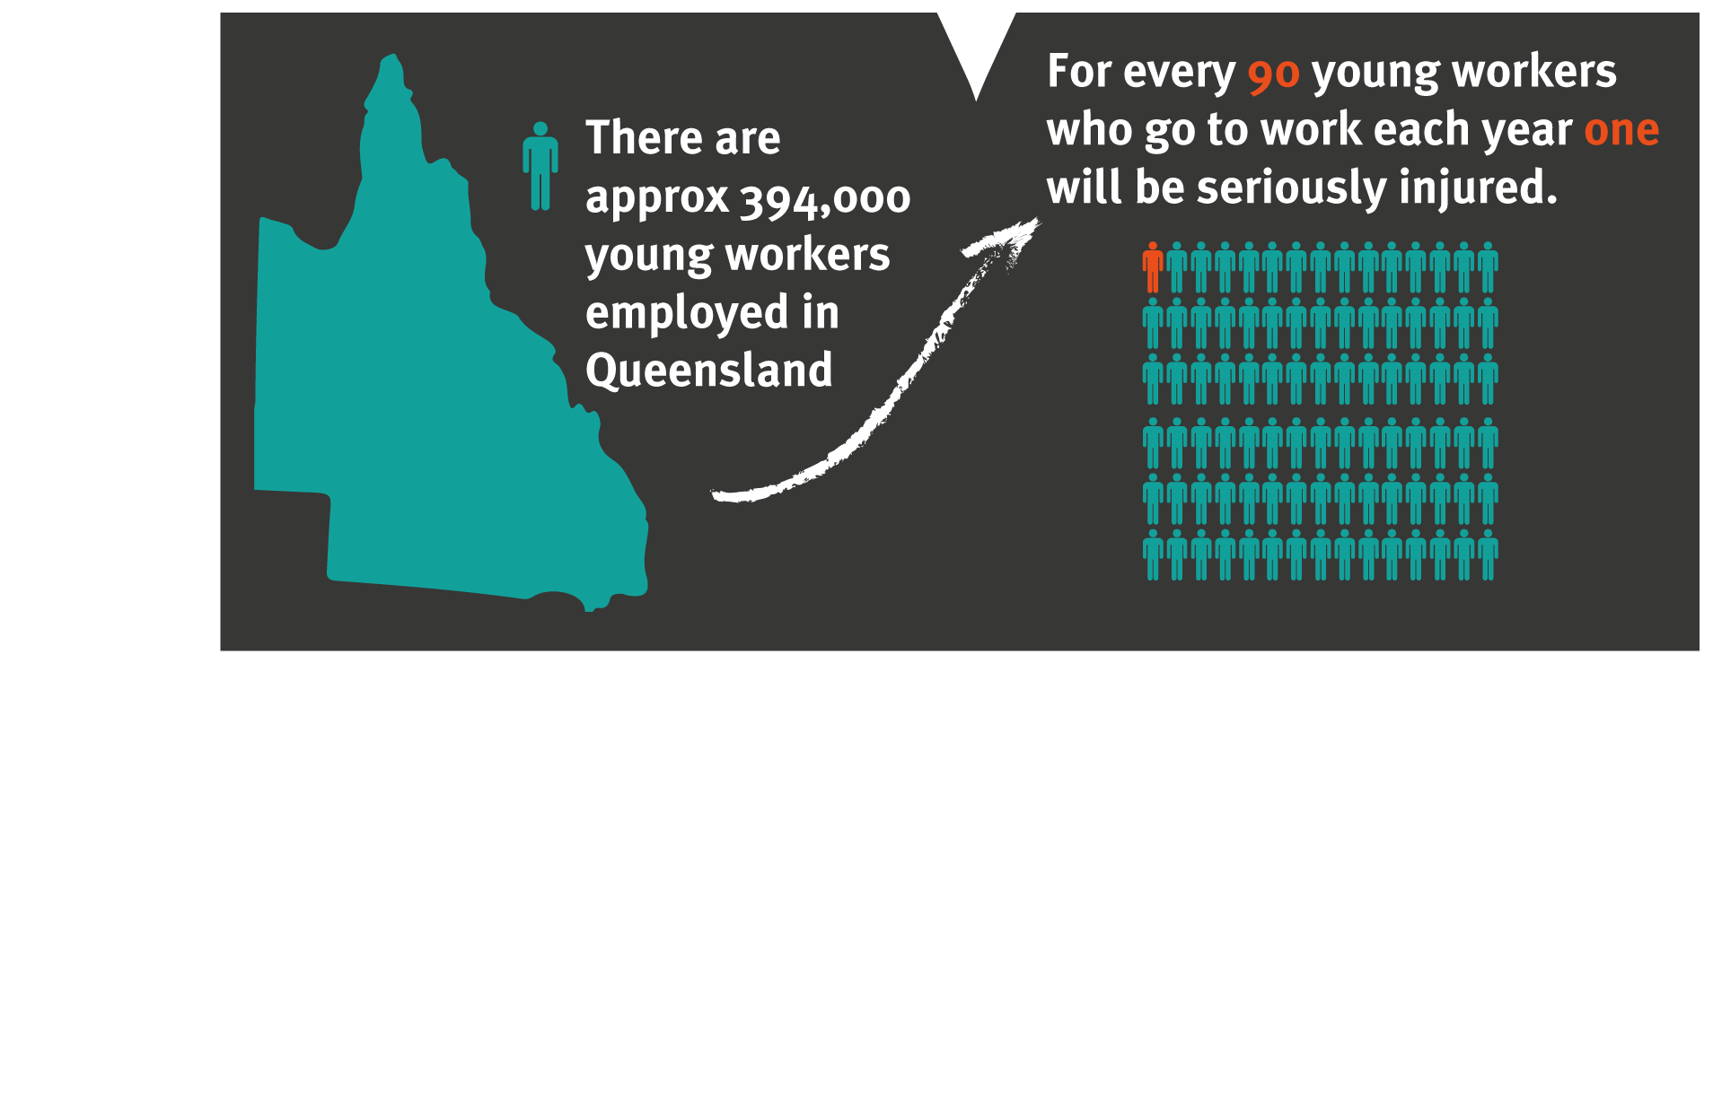
The need to take action
4400 people aged between 15 and 24 years are seriously injured at work every year in Queensland.
Notes:
There are 4400 young workers (aged 15-24) seriously injured at work each year in Queensland.
A serious injury keeps someone off work for five or more days.
That equates to around one out of every 90 young workers suffering a serious injury at work each year.

Slide 5
Injury hotspots for young workers aged 15-24 years
All industries, serious injury claims
Notes:
The top two types of injuries are:
Injuries to muscles and joints - “these injuries include things like joint sprains and muscle strains/tears”
Wounds, lacerations and amputations.

Slide 6
Every injury has its own story…
Watch Jason’s film
Notes:
Jason Daniels' story – surviving an electric shock from overhead powerlines, is a film about how quickly life changed for Jason’s family when the grain auger he was moving contacted an overhead powerline.
Jason was just 17 when the serious electric shock he received from the powerline gave him horrific injuries. Jason’s mother Di Daniels recalls the devastating phone call she received on the day it happened and the struggles they have faced throughout Jason’s recovery.
Jason and Di are sharing their experience in this raw and real film to raise awareness about having a safe system of work in place before starting work and urging employers to listen when young workers speak up with safety concerns.
‘Life can change in a heartbeat’ - Di Daniels.
https://www.worksafe.qld.gov.au/resources/videos/films/jason-daniels-story

Slide 7
Every injury has its own story…
Watch Dale Kennedy’s film
Notes:
Debbie and Dan Kennedy are Workplace Health and Safety Queensland Safety Advocates.
Their son Dale was working in a ceiling space when he died from an electric shock. Dale was only 20 and close to finishing his electrical apprenticeship. He was also a young father himself.
Debbie and Dan share their story to encourage workers (especially young workers), to voice their concerns if they see something that is unsafe, and to always turn the power off before working in a ceiling space.
"If you have been asked to do something unsafe just say no, it’s not worth it. You're a stronger person if you stand up for your own safety, we want you to go home at the end of the day to your loved ones.“
ADDITIONAL RESOURCE: Jason’s Story
Michael’s son Jason was just 20 years old when he was electrocuted at a construction site in Clermont in 2012. He had only been working there for nine days.
Jason's family and friends have shared their experiences to raise awareness about the importance of workplace safety and the need for effective communication between sub-contractors on construction sites, and appropriate supervision and supportive mentoring of young workers.
"The old and wiser should be looking after the young and inexperienced, and for the younger guys who are doing a job, if you don’t know—ask. If you’re left unsupervised and don’t know how to do a task, ask to be supervised, it’s as simple as that. Be an advocate for your own safety—we want to prevent deaths happening out there.“
Watch and download the film - https://www.worksafe.qld.gov.au/resources/campaigns/safety-advocates/michael-garrels
You can also request a safety advocate visit your workplace - Michael (Jason’s Dad) visits Queensland businesses as a Safety Advocate to highlight what it’s like to lose a child to a preventable workplace incident. Michael raises awareness of the importance of workplace safety and the need for effective communication between sub-contractors on construction sites, and appropriate supervision and supportive mentoring of young workers. Visit https://www.worksafe.qld.gov.au/resources/campaigns/safety-advocates to book your presentation.

Slide 8
Self-reflection
Take a moment to think about yourself at 20 years old.
How could a serious injury have affected your life (or your loved ones)?
How influential were your co-workers and supervisors?
Notes:
Use discussion questions on slides 9 and 10 as a prompt for group discussion about considering health and safety of young workers in your workplace.

Slide 9
The need to take action
How many young workers are in this workplace?
What kinds of jobs do young workers do?
Could these injuries happen in this workplace?
Notes:
Use discussion questions on slides 8 and 9 as a prompt for group discussion about considering health and safety of young workers in your workplace.

Slide 10
Section two:
How to influence the health and safety of young workers

Slide 11
Work health and safety laws
Your employer’s responsibilities | Your responsibilities | Your rights
Provide a safe work environment. Provide information, training, instruction and supervision. Talk with you about health and safety. Appoint a safety committee or safety representatives if requested. | Take reasonable care of your health and safety. Don’t endanger other people through your actions. Follow reasonable instructions and policies. | Stop or refuse unsafe work. No negative repercussions for raising health and safety concerns. Elect a health and safety representative.
Notes:
There are laws that set out what the responsibilities of both employers and workers are with workplace health and safety.
As a worker, your safety is covered by the laws regardless of whether you are a direct employee, apprentice, trainee, labour hire or work experience placement.
Workers also have rights that are set out in these laws – including the right to stop work or refuse to do something if it is unsafe.
Workers can also elect a health and safety representative. (Make sure the group is aware of who the representatives are on this worksite.)

Slide 12
Supervisors TV commercial
Watch the advert
Copyright Worksafe Victoria
Notes:
This next film shows a young worker being asked to do something unsafe by their supervisor to get their work done. Would you ask a young worker to do this work?
To use this presentation offline, download the full version of the film at: https://www.youtube.com/watch?v=L2Wlf0rpmPk

Slide 13
Video follow up
How likely is it that the young worker would speak up or raise concerns?
Who has the biggest influence over the young workers’ health and safety at work?
What is the key message?
Notes:
Lead group discussion

Slide 14
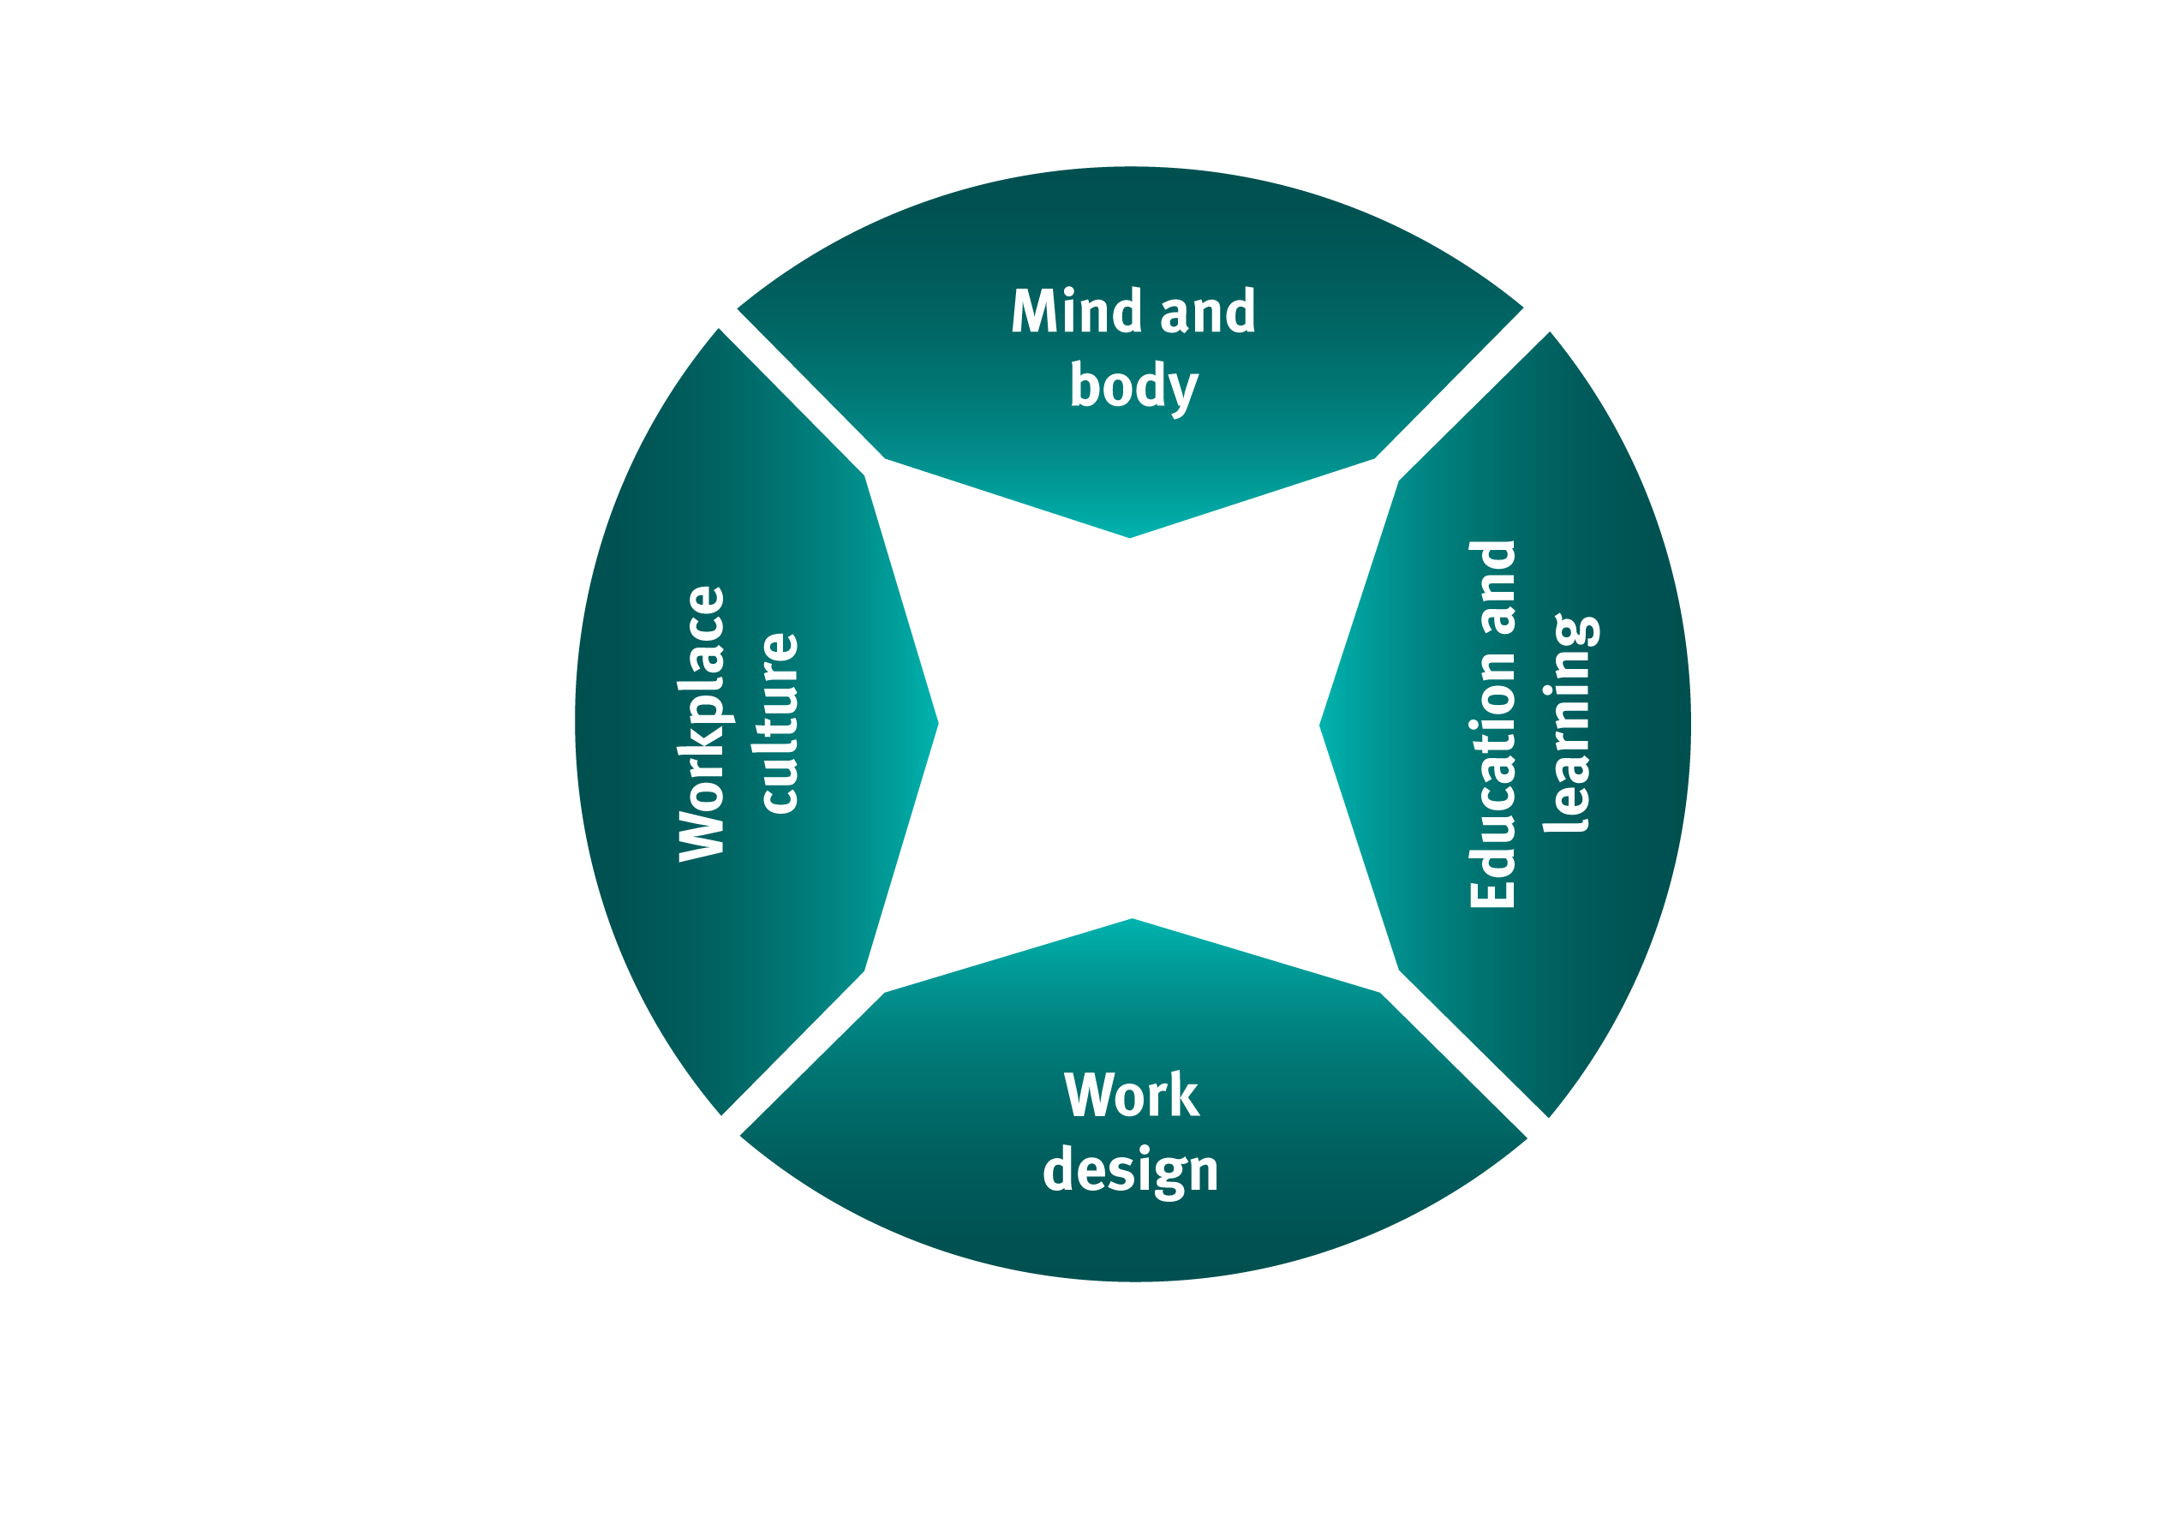
Risk profile
Peer influence
Risk-taking
How to influence the health and safety of young workers
Organisational values
Leadership
Consultation and communication
Risk management capability
Education and training programs
Work experience
Induction and training
Supervision and feedback
Social support and mentoring
Notes:
This model shows the four areas that influence the health and safety of young workers.
Within each area, there are a number of people who have the ability to support young people.
For supervisors and managers of young workers, it is important to:
have an understanding of the Mind and Body and Education and Learning sections, and
apply this understanding to the Work Design and Workplace Culture sections.

Slide 15
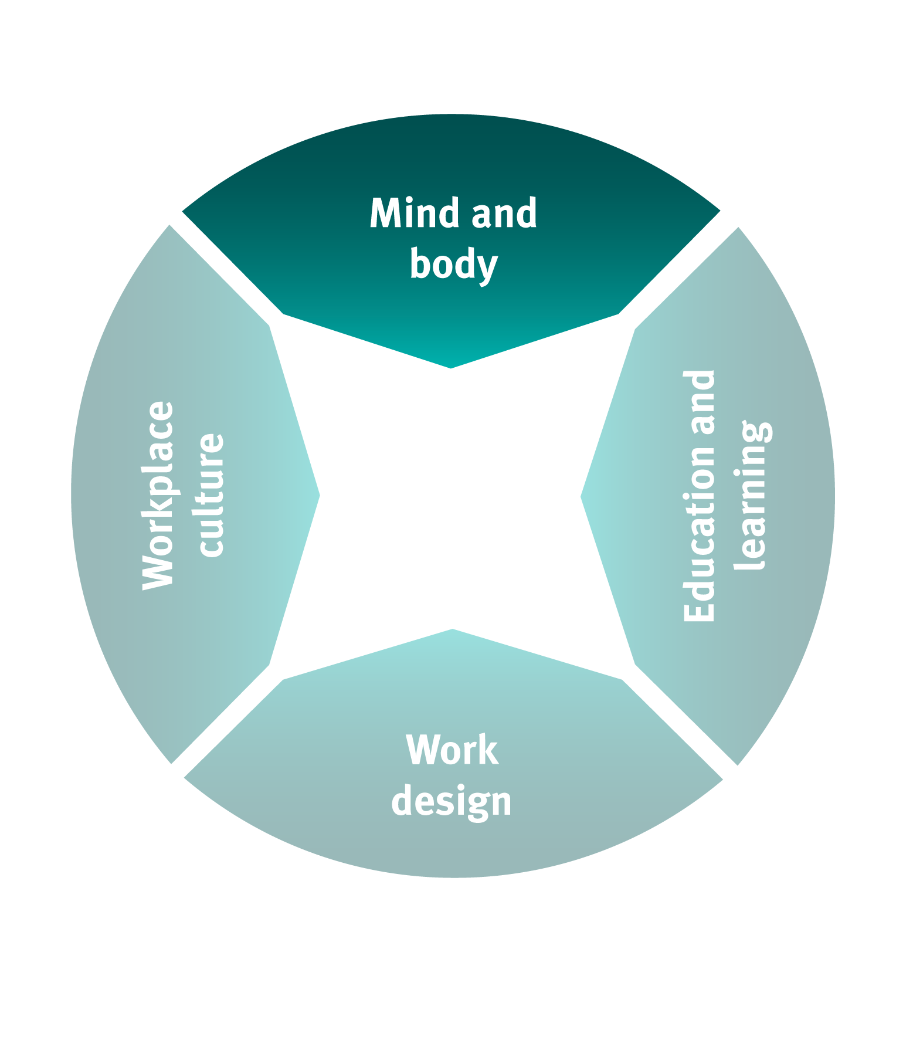
Mind and body
Risk profile
Inexperience
Development (physical, social, intellectual)
Generational
Peer influence
Risk-taking
Notes:
Understanding the Mind and body factors of young workers can help to influence their behaviour.
Young workers are at a different stage of physical, social and intellectual development.
Young people are likely to model their behavior off others.
They are also not as good at perceiving when something becomes risky so they are more likely to take risks.
All of these factors mean that relying on young workers to speak up when they feel unsafe or ask questions is not enough.

Slide 16
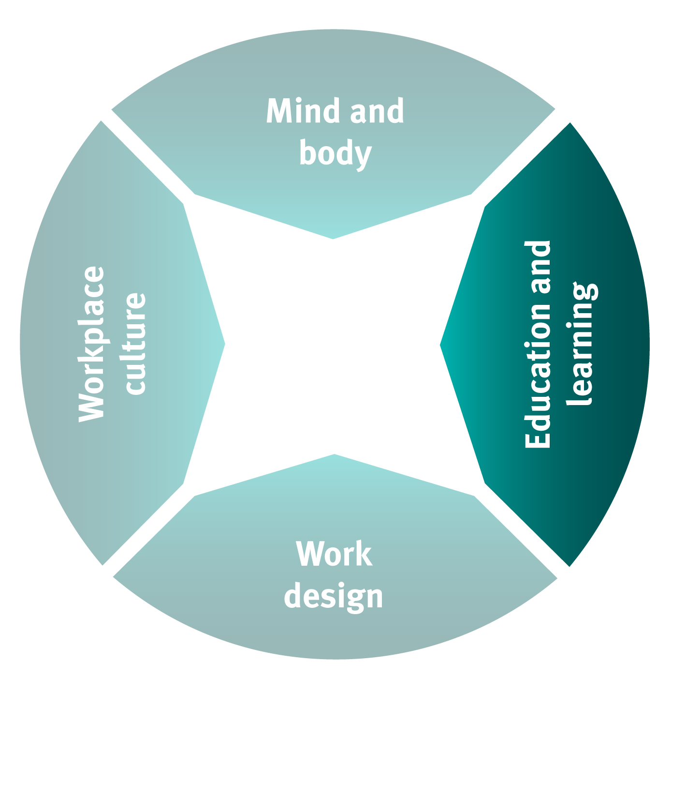
Education and learning
Education and training programs
Risk management capability
Work experience
Notes:
Education and Learning helps to develop young workers’ ability to manage risks.
This ability comes from education and training programs, but on-the-job experience is just as important.
Supporting young workers to apply what they have learnt is important for supervisors and managers.

Slide 17
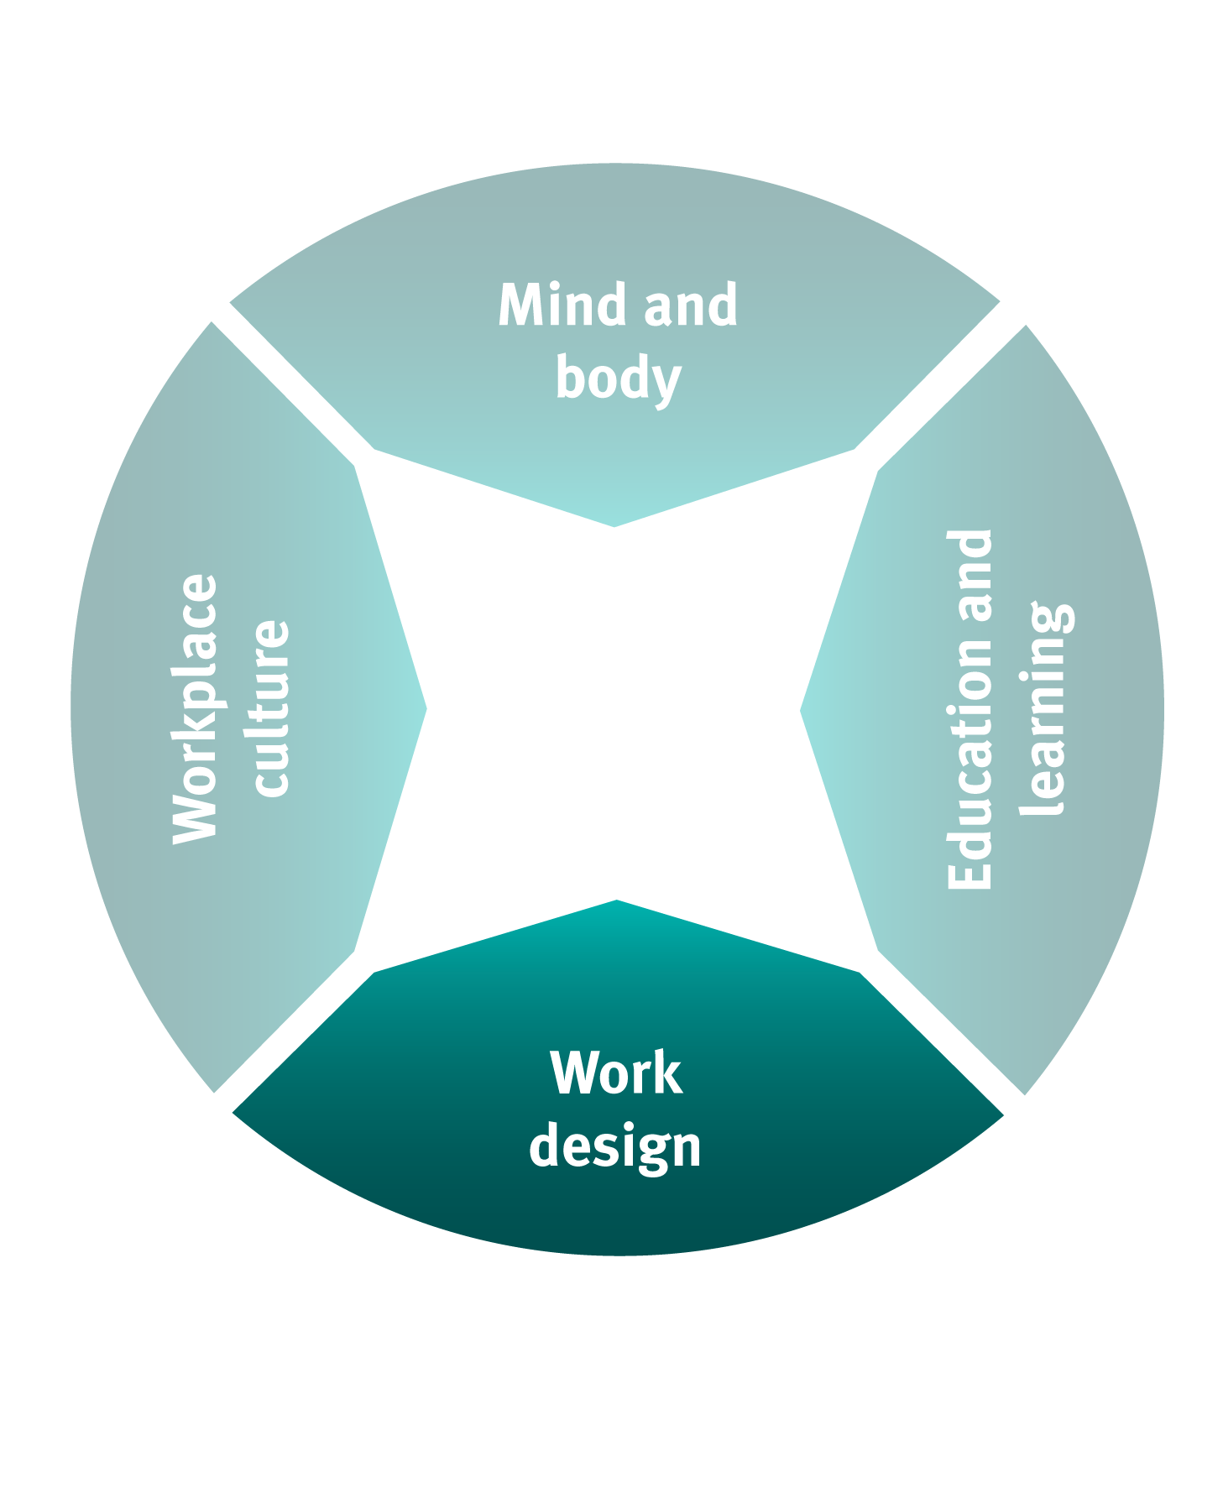
Work design
Induction and training
Supervision and feedback
Social support and mentoring
Notes:
Work Design refers to those things that are done to ensure that young workers are safe in the work that they are doing.
The three most important components of good work design are:
Induction and training – providing young workers the information that they need to perform tasks safely and checking that they understand the instructions given.
Supervision and feedback – ensuring that the level of supervision provided is appropriate for the task a young worker is performing and providing constructive feedback about their performance, including recognition for a job well done.
Support and mentoring – helping young workers engage with their workplace and co-workers by developing good relationships and providing them with a mentor.

Slide 18
The right start – building safe work for young workers
Watch ‘The right start’ film
Notes:
The right start film is a good example of the three things a supervisor or manager can do to keep a young worker safe.

Slide 19
Question time
What were the three things used in the good example to keep the young worker safe?
Notes:
Lead group discussion.

Slide 20
Question time
What were the three things used in the good example to keep the young worker safe?
Induction and training
Supervision and feedback
Support and mentoring
Notes:
Lead group discussion.

Slide 21
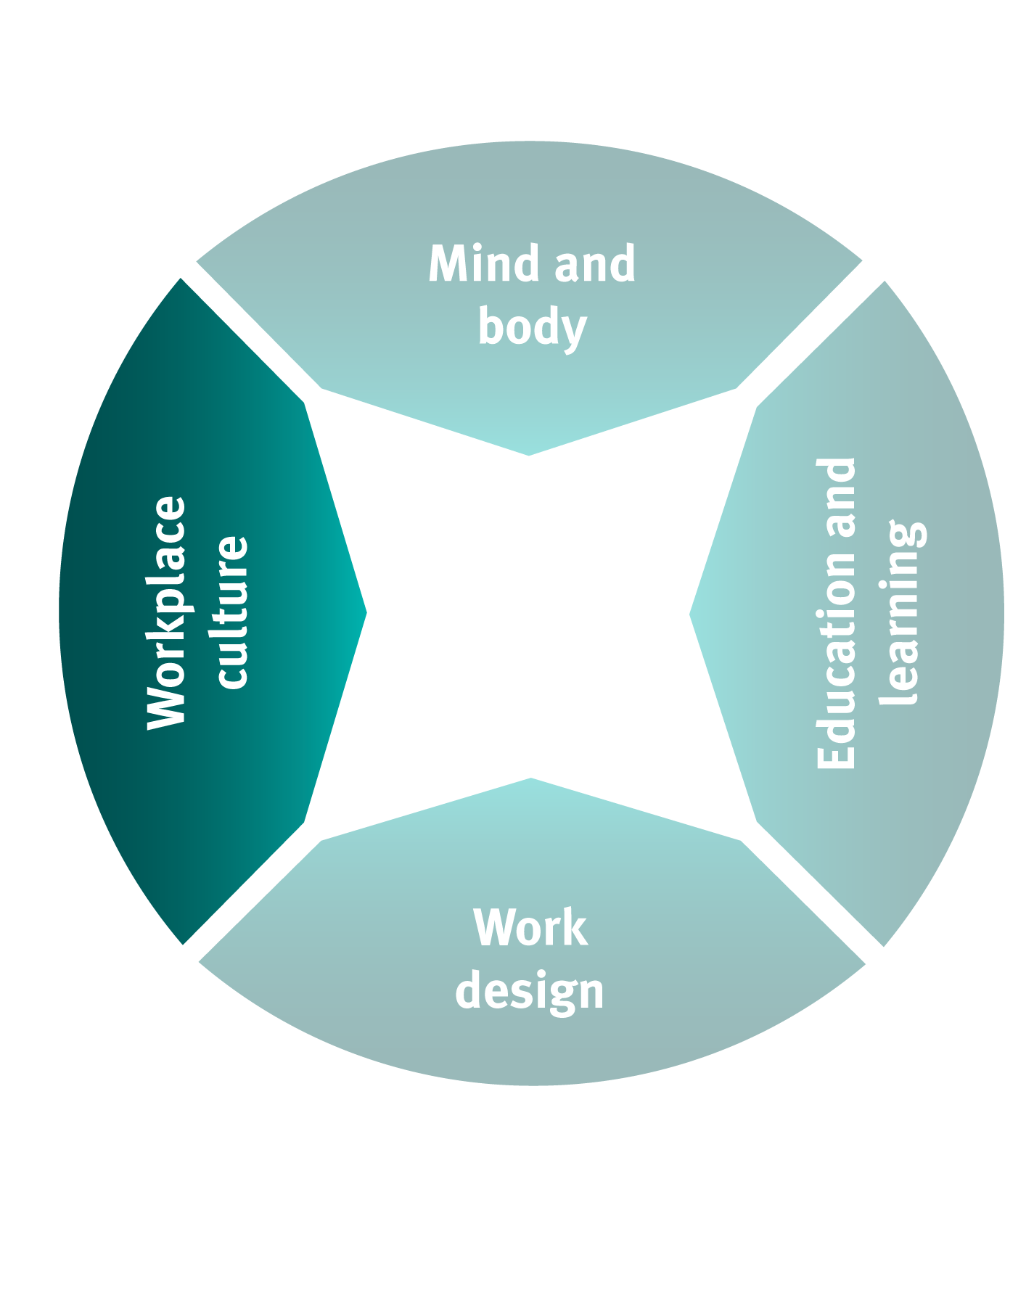
Workplace culture
Organisational values
Leadership
Consultation and communication
Notes:
A positive Workplace Culture that is successful in supporting the health and safety of young workers needs to:
value the health and safety of young workers
have managers and supervisors demonstrating leadership
consult with young workers about their views and use effective ways to communicate.

Slide 22
The right start – shaping a culture of safety for your workers
Watch ‘The right start’ film
Notes:
The right start – shaping a culture of safety for your workers film is a good example of the three things a supervisor or manager can do to keep a young worker safe

Slide 23
Section three:
Workshop – ideas for improvements

Slide 24
Workshop
Mind and body:
What is the risk profile of young workers?
How do we raise awareness of this within the workplace?
Who needs to be involved?
Notes:
Young worker risk profile (from slide 15)
Inexperience
Development (physical, social, intellectual)
Generational
Use the discussion questions in slides 23-26 to workshop ideas for what can be done within each of the four sections to improve the way that young workers are supported with health and safety.
This can be done by breaking into smaller groups or as one large group.
Allow at least 3-5 mins for people to discuss and write down their ideas for each section, then 2-3 mins to report back.
Have someone take notes of everyone’s ideas for Section four.

Slide 25
Workshop
Education and learning:
How can we help education and training providers to improve health and safety knowledge of young workers?
How can we include health and safety as a priority when we host young people on work experience placements?

Slide 26
Workshop
Work design:
How can we improve the quality and relevance of inductions and training?
How can we improve the quality of the supervision and feedback we provide to young workers?
How can we better support and mentor our young workers?
Notes:
1. Consider the risk profile of young workers.
2. Design work that effectively manages risk.
Induction and training
Supervision and feedback
Support and mentoring.
3. Create a culture that engages, supports and develops.
4. Ensure relevant methods of communication.

Slide 27
Workshop
Workplace culture:
How can we demonstrate our commitment to keeping young workers safe?
How can we support our supervisors to be able to keep young workers safe?
How can we improve our consultation and communication with young workers?
Notes:
Be alert for situations where peer influence could lead to young workers taking risks in an attempt to ‘fit in’

Slide 28
Section four:
Taking action

Slide 29
Taking action
Prioritise | List the top three ideas for improvement from the workshop.
Commit | Commit to making these improvements happen.
Plan | Outline the steps required.
Identify roles | Identify those people responsible for taking each of these steps.
Implement | Undertake the activities required to make the changes.
Report back | Set a date to report back on progress.
Notes:
Use the steps outlined here to work out a plan of action to make the top three ideas happen as decided by the group.

Slide 30
Where to get more information
Visit worksafe.qld.gov.au
Guidance material
Films
Case studies
Industry-specific information
Sign up for eSAFE (free e-newsletter service) at worksafe.qld.gov.au
Contact a WHSQ Inspector in your region for further assistance.
Phone the WHS Infoline on 1300 362 128.
Notes:
Close the session by nominating a date to follow up with the group and for people to report back on the progress they have made.

